Slide 2
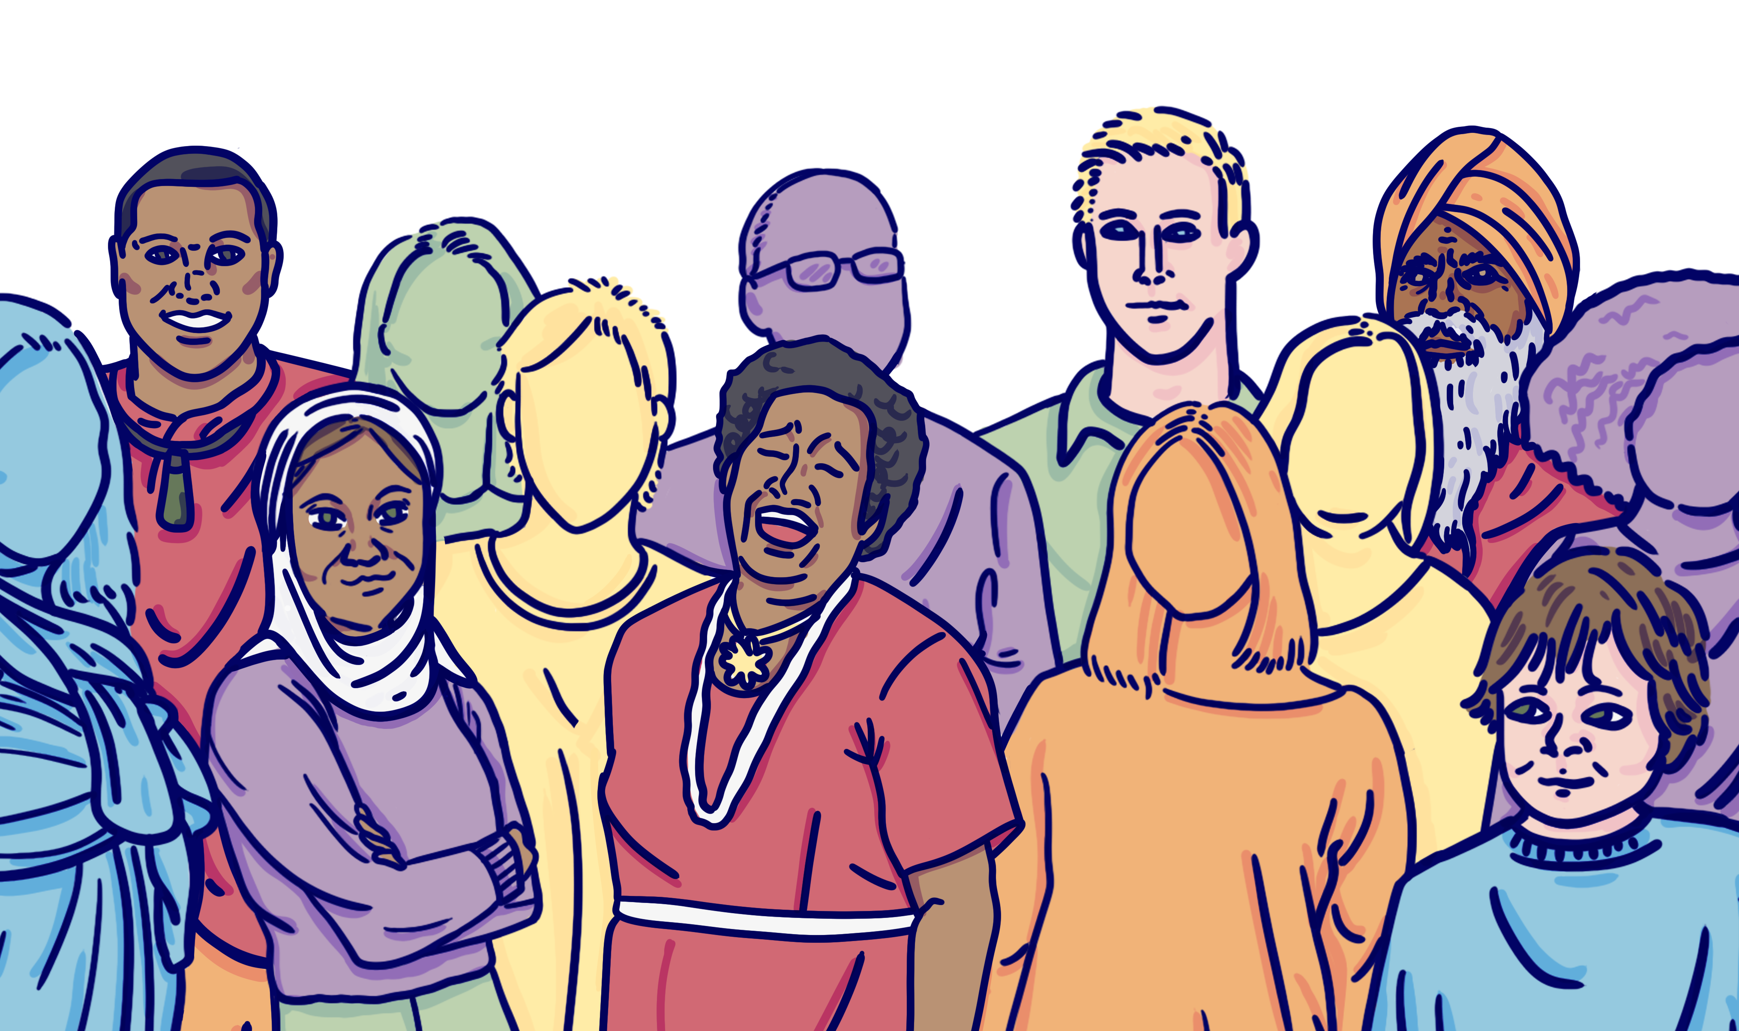
Standing Together Against Hate
Whether we are at work, school, home, or in public, we all deserve to live a life free from hate.
This short education pack is an opportunity to reflect on what hate is, the impact hate has, and what we can all do to stand together against hate.
The stories shared here are heartfelt and real. These stories represent intersectionality and the diversity of Aotearoa. We hope you can recognise parts of yourself, your family, friends, or colleagues in each story.
To find out more (and for other great resources) visit standingtogether.govt.nz

Slide 3
Let’s take a closer look at some of the micro-aggressions described, and think about the harm these can cause.

Slide 4
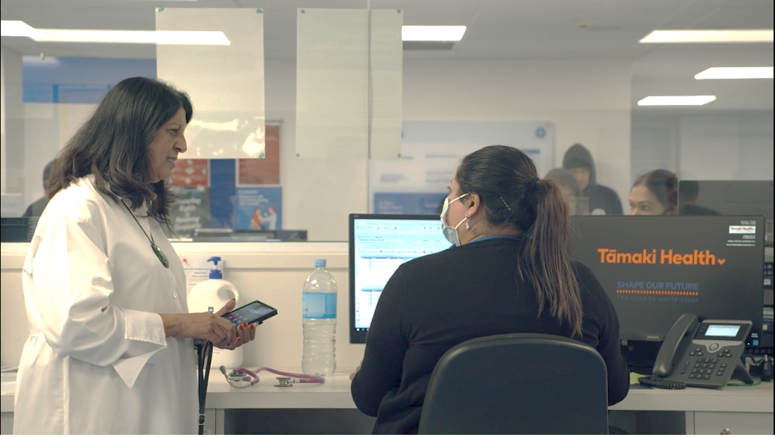
“Our peers all thought ‘must be that dodgy Indian couple’.”
The stereotyping Ranjna is describing is an example of a ‘micro-aggression’, a commonplace verbal or behavioural slight.
What impact might this daily prejudice have on Ranjna?
Notes:
Some notes to help guide the kōrero:
Experiencing sometimes daily prejudice, persecution, and micro-aggressions can build up over time causing immense harm to the person, their whānau, and their communities.
Microaggressions are described as “the everyday verbal, nonverbal, and environmental slights, snubs, or insults, whether intentional or unintentional, which communicate hostile, derogatory, or negative messages to target persons based solely upon their marginalized group membership.” (https://www.psychologytoday.com/nz/blog/microaggressions-in-everyday-life/201011/microaggressions-more-just-race)
Microaggressions can:
reduce someone’s feeling of psychological safety
create feelings of isolation
undermine morale in the workplace and create a toxic environment for all
cause someone to lose self-esteem
lead to feelings of exhaustion
increase burnout
negatively impact someone’s physical health and stress levels

Slide 5
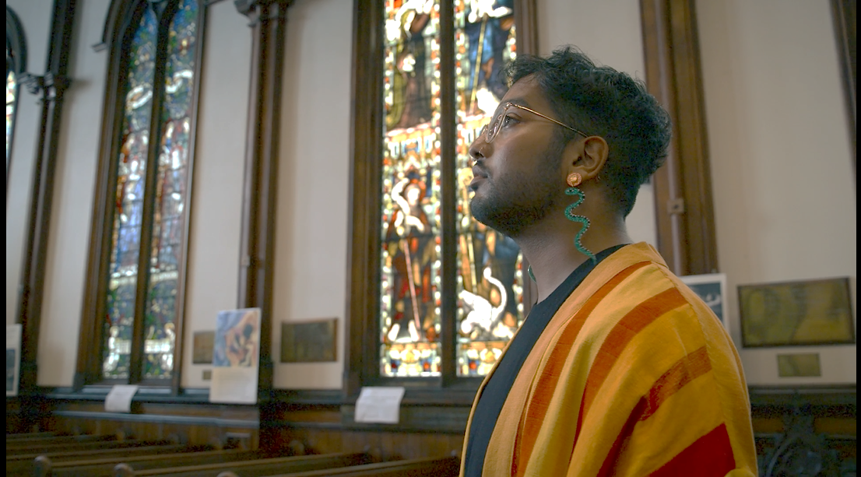
“I realised most of my life was a conversion practice.”
Shawn describes experiences at school as ‘forcing me to be something I'm not, restricting me from being who I am’.
Think about your experience of school. Do you identify with Shawn’s experience? What impact would their experience have had on them?
Notes:
Some notes to help guide the kōrero:
Conversion practices could include, but are not limited to:
using shame, coercion or other tactics to try to give a person an aversion to same-sex attractions, or to encourage gender-conforming behaviour
encouraging someone to believe their sexuality or gender, or parts thereof, are defective or disordered, or
performing a deliverance, exorcism or prayer-based practice intended to change or suppress a person's sexual orientation, gender expression or gender identity
There is no evidence that such practices can change sexuality or gender, and numerous studies have shown they can cause significant and long-lasting harm. People with lived experiences of conversion practices are often called survivors.
(https://tikatangata.org.nz/resources-and-support/guidelines/guidelines-on-conversion-practices)
There have been reports outlining the negative impacts of conversion practices on the mental wellbeing of many rainbow New Zealanders. These have included low self-esteem, anxiety, depression, and suicidal thoughts and attempts.
(https://www.parliament.nz/en/get-involved/topics/all-current-topics/prohibiting-conversion-practices-in-new-Zealand)
Young queer people are five times more likely to attempt suicide than non-queer people.
https://www.nzherald.co.nz/nz/break-the-silence-rainbow-suicide-rate-five-times-higher-than-mainstream/FWYOOOWGPFRTMZLAJONQ3MJQRY/
From 19 February 2022 it is an offence to perform conversion practices on someone under the age of 18 or on someone who lacks decision-making capacity. It is also an offence to perform conversion practices on someone 18 years or older where that causes serious harm.
(https://tikatangata.org.nz/resources-and-support/guidelines/guidelines-on-conversion-practices)

Slide 6
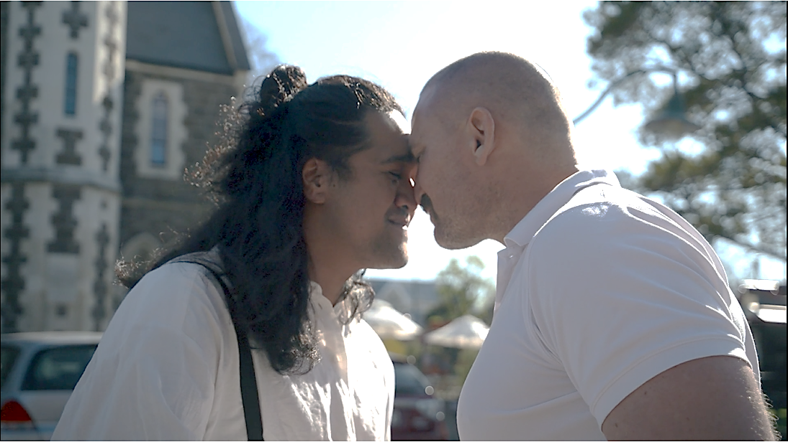
“I'll never forget feeling like I was so different. People…were so prepared to let me know about that”
Mananui describes being made to feel as if he didn’t belong because he is Māori. These kind of micro-aggressions cause waves of harm – they are directed at one person but can impact many people.
Alongside Mananui, who else might have been negatively impacted?
Notes:
Some notes to help guide the kōrero:
Hate-motivated behaviour is designed to send a message – they target an individual to send a message to a community.
Fear spreads quickly throughout communities. These waves of harm ripple out from an individual, to a whanau, to a community (in this case Māori) and beyond, into our society.
Trying to protect their loved ones from these waves of harm can leave people feeling isolated and alone, managing high levels of stress and anxiety.
(https://www.researchgate.net/figure/Waves-of-harm-generated-by-hate-crimes-Adapted-from-Iganski-2001-629-by-Fingerle-and_fig1_351996037)

Slide 7
Hate-motivated behaviour can escalate.
Giving support, getting support, and making a report can help.

Slide 8
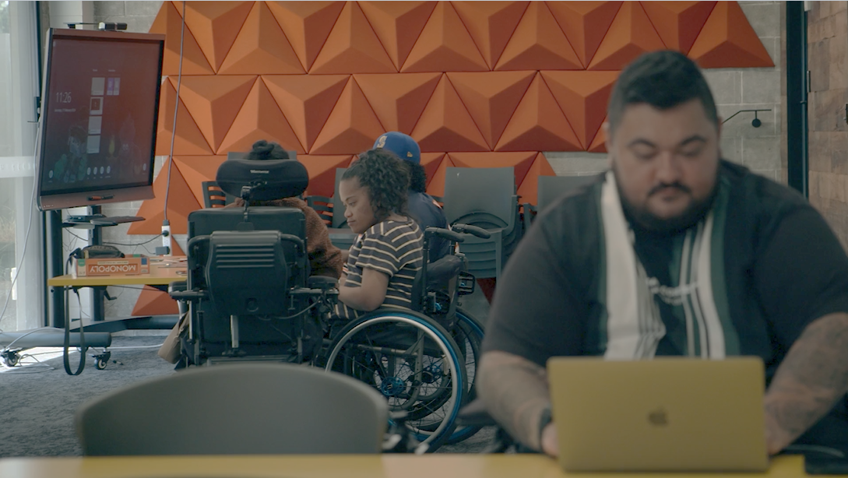
“He can't do this. Can't do that”
“Shouldn't he be staying home?”
“Oh, why is he going to work?”
What does Kramer mean when he says:
“Treat me as a person because, y’know, I am the person before the disability”?
Notes:
Some notes to help guide the kōrero:
Don’t make assumptions about someone because of one aspect of their identity
It is a show of respect to see the whole person
How does your workplace or school create an inclusive environment?

Slide 9
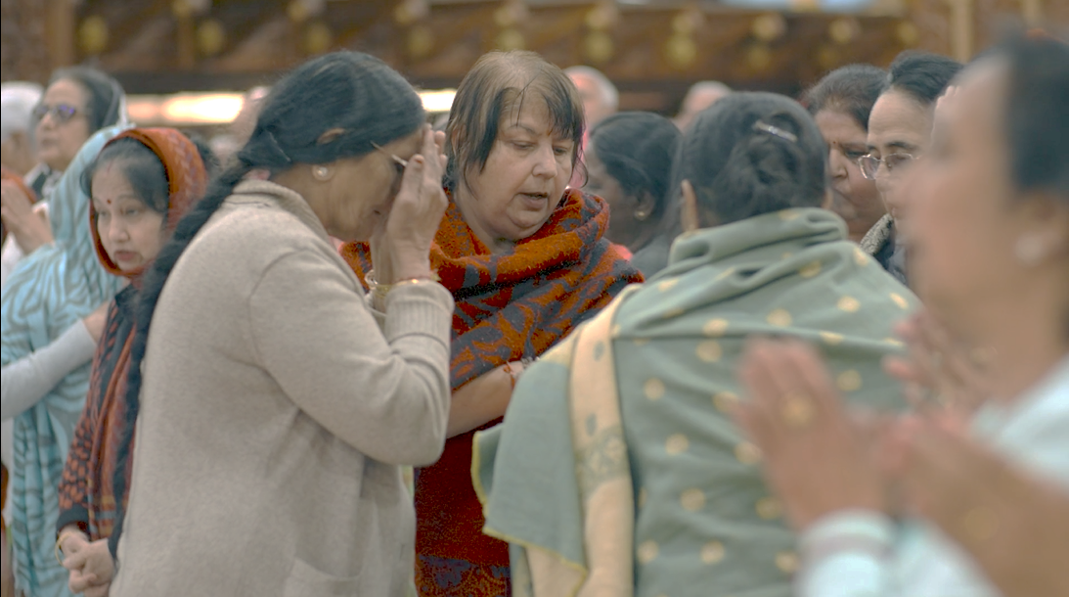
“We are just accepting intolerance from everybody, which then becomes ignorance, which becomes hate.”
Ranjna describes hate growing from intolerance and ignorance - do you agree?
What does it mean to ‘accept intolerance’?
Notes:
Some notes to help guide the kōrero:
It means to do nothing
It means to ‘let comments slide’
It means to not be an ally
It means to not have courageous conversations
Is intolerance accepted or called out in your school or workplace?

Slide 10
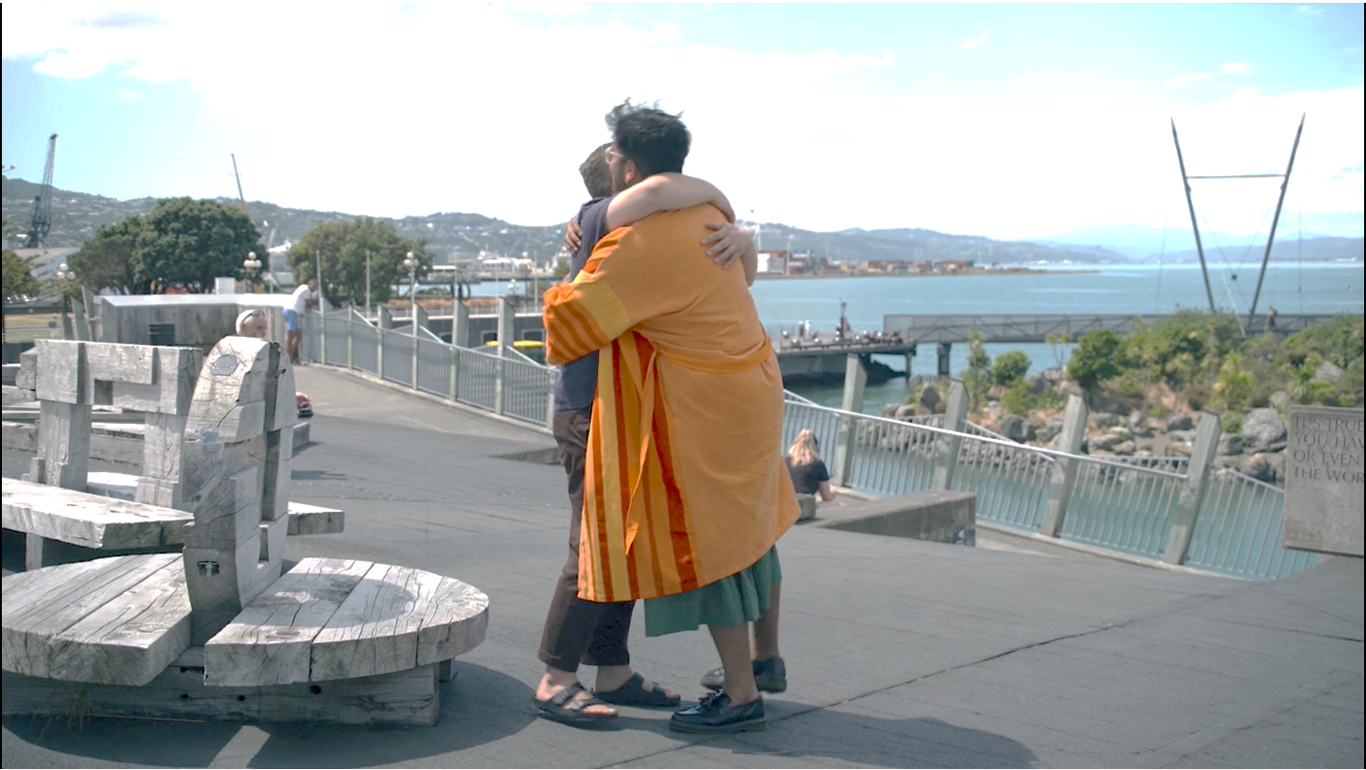
“For the first time in my life in New Zealand, my dad said please be careful, son.”
“That attack gave so much fuel for it to be okay, to slur at or comment on, or be even more condescending to people who presented like me.”
We know that hate can spread quickly, and can create communities of victims.
What actions could you take to address hate-motivated behaviour in your workplace or school?
“And he knew that.”
Notes:
Some notes to help guide the kōrero:
Think about your role – can you influence policy, practice, culture and/or team-building activities in your school or workplace?
What collective action can we take?
What small but meaningful actions can we take in our everyday?
What networks already exist that you could support or tap into?

Slide 11
“The head scarf was taken off, and pushed them, and told them go back where you come from.”
Arif describes a hate-motivated crime.
What can you do if you witness something like this occurrring?
Notes:
Some notes to help guide the kōrero:
Experiencing hate can cause immense harm and fear through our communities.
If you, your friends or whānau have been impacted by hateful behaviour, it is important to support, record, and report.
Support: Make sure that you and any other affected people are in a safe place, away from the offender. If you are a witness, make it clear that the person(s) affected are not alone and that you are there to support them.
Record it Any evidence recorded or preserved from the incident could be important if there is an investigation. If it is possible to do so safely, you can:
• Record a video or take photos of the incident
• Preserve any physical evidence
• Write down details of the time, location, and people (or descriptions of people) involved.
3. Report it You can report directly to an agency or tell the nearest person in authority or a responsible person - this could be a bus driver, security guard or reception desk. You can also tell someone you trust who can support and help you report the incident.
Call 111 if someone is in danger.

Slide 12
We all have a role to play in reducing prejudice.

Slide 13
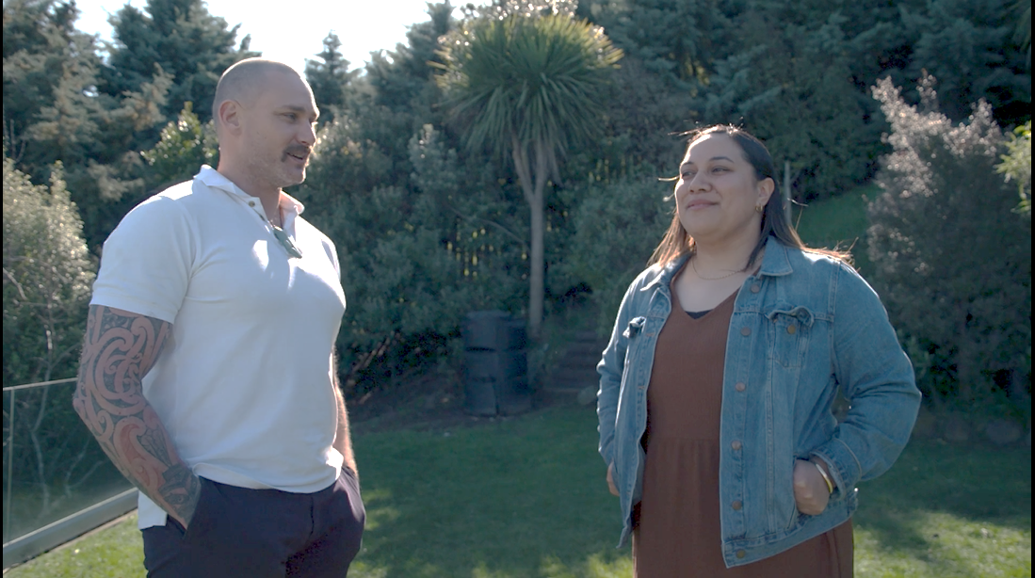
“It starts and finishes in the house.”
“You could argue it actually starts and finishes within yourself as well.”
Mananui links home, personal responsibility and our behaviours in the community.
How can you role model good behaviour to reduce ignorance and prejudice?
“Am I role modelling good behaviours in the community beyond that point?”
Notes:
Some notes to help guide the kōrero:
Who are your role models?
Who are you a role model for?
Are role models always obvious?
How can we influence online?
Kindly call out negative behaviour
Address and reflect on our own prejudice
Have conversations about prejudice with your friends, whānau, colleagues, classmates
What causes prejudice
What causes someone to act on their prejudice
How can we support reducing prejudice

Slide 14
Notes:
Thank you!
Please direct learners to visit standingtogether.govt.nz to continue their journey ☺

