Slide 1
SAFER SCHOOLS
Session 4
Notes:
Version 1.2

Slide 2
REVIEW: NATURAL SURVEILLANCE
NS in an environment allows people to see and be seen.
NS deters crime because people do not want to be seen committing offences.
NS can be improved by:
using materials that people can see through
designing environments where people have clear sightlines
encouraging people to use the environment so there are more people seeing what is happening in that environment.

Slide 3
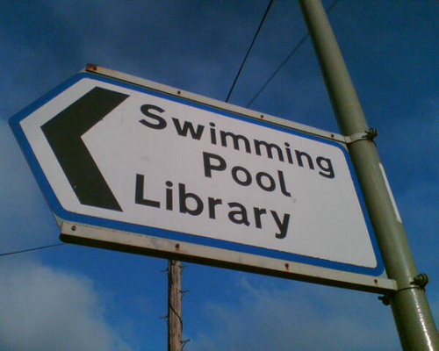
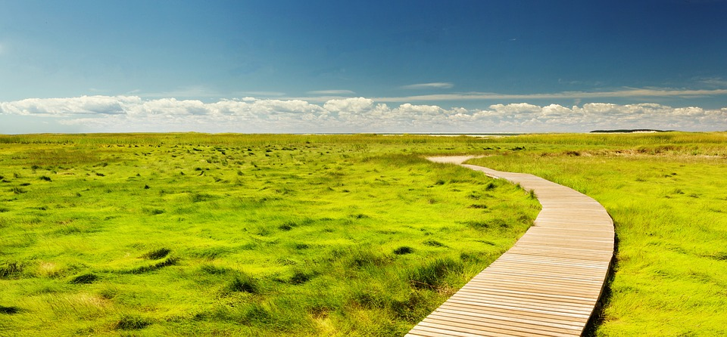
REVIEW: ACCESS MANAGEMENT?
ACCESS MANAGEMENT:
focuses on clear, direct walkways and clear signage
deters crime because it reduces the possibility of offenders making excuses for where they shouldn’t be.

Slide 4
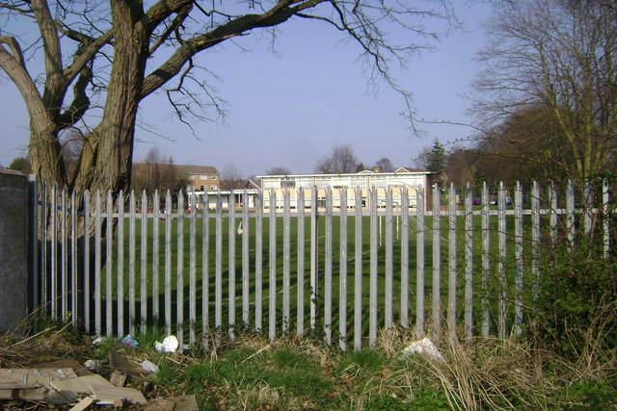
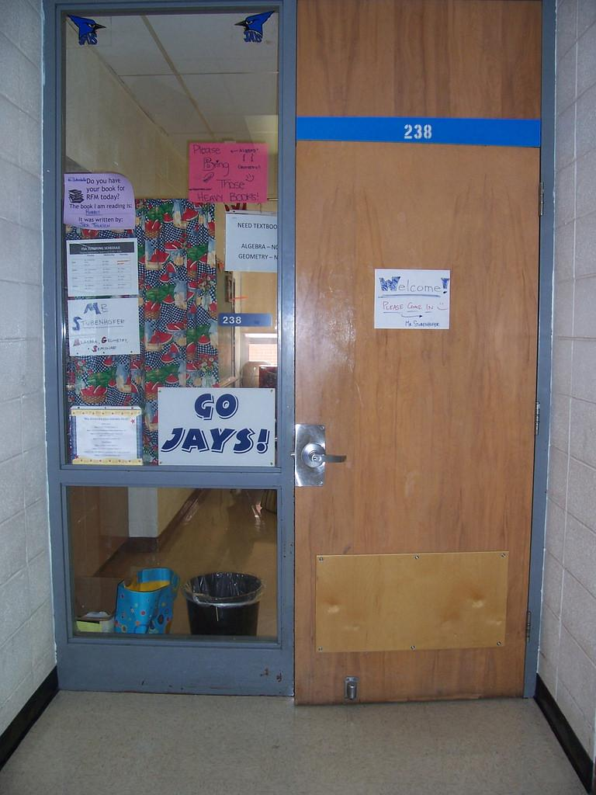
REVIEW: TERRITORIAL REINFORCEMENT
TERRITORIAL REINFORCEMENT:
focuses on the importance of having areas clearly defined so that public, private and semi-private areas are obvious.
Examples:
Fences define the school boundary, and this area is public.
Classrooms are semi-private.
The Principal’s office is private.

Slide 5
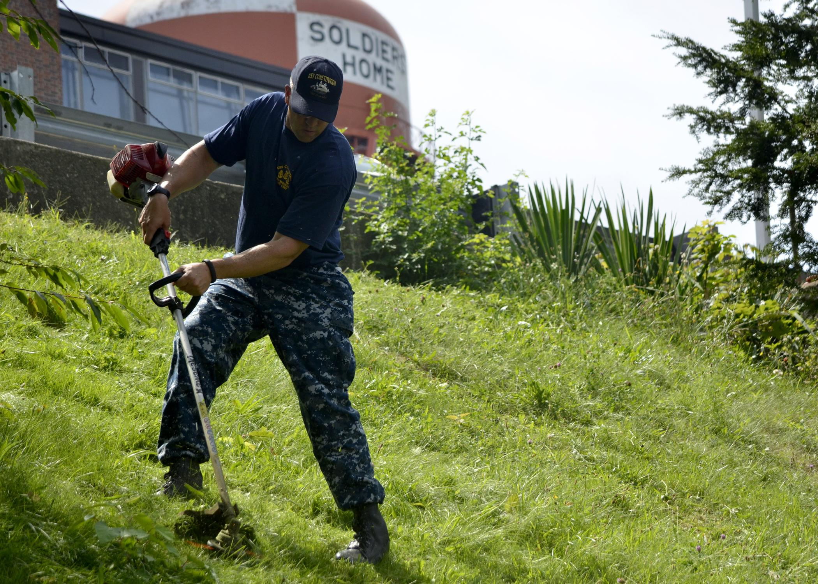
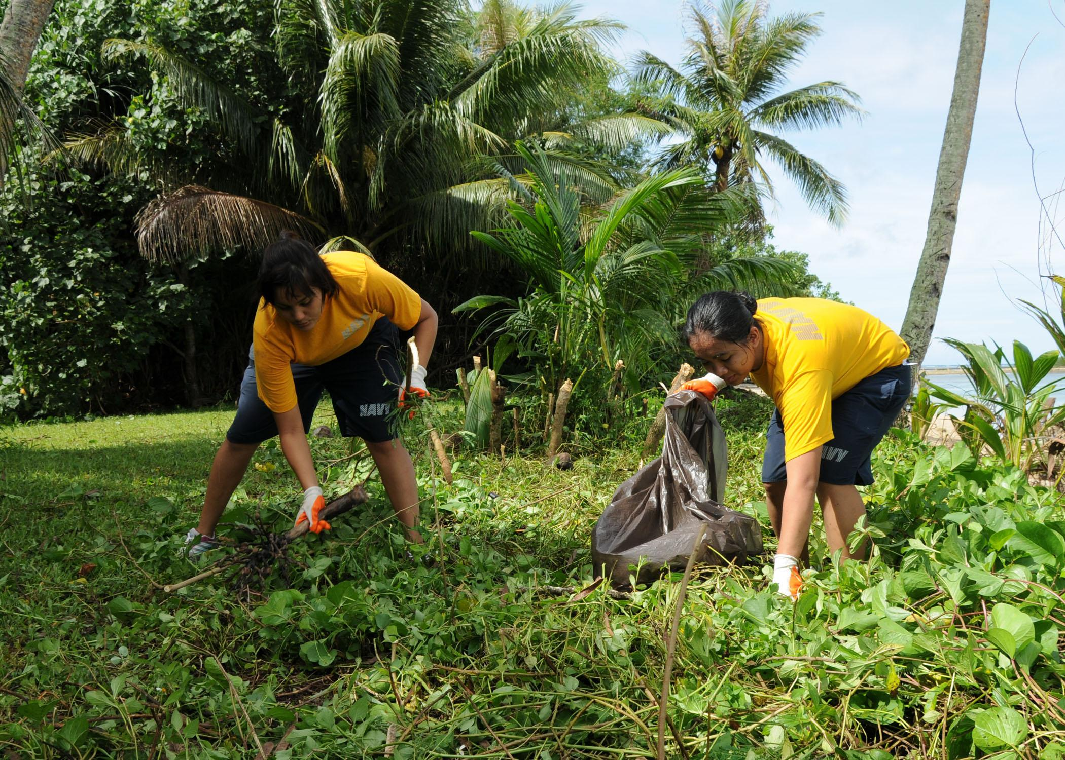
What is a Quality Environment?
Focuses on the importance of maintaining an environment so that it looks cared for.
How does a quality environment deter crime?
A maintained environment means people care about the environment, are more likely to be present, and therefore it is less likely to be targeted by offenders.

Slide 6
YOUR TURN:
Apply the principle of Quality Environments.
INVESTIGATION STARTER (10 minutes)
What is a Quality Environment?
What evidence is there that our school is a well maintained quality environment?
How does a maintained school affect how you feel about your school?
What areas within our school need better maintenance to make them a quality environment? Why?
Then CHECKLIST and PHOTOS (15-30 minutes)

