Slide 1
SAFER SCHOOLS
Session 3
Notes:
Version 1.2

Slide 2
REVIEW: NATURAL SURVEILLANCE
NATURAL SURVEILLANCE in an environment allows people to see and be seen.
NS deters crime because people do not want to be seen committing offences.
NS can be improved by:
using materials that people can see through
designing environments where people have clear sightlines
encouraging people to use the environment so there are more people seeing what is happening in that environment.

Slide 3
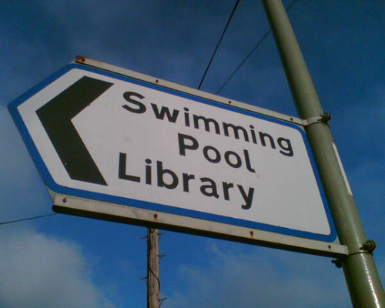
REVIEW: ACCESS MANAGEMENT
ACCESS MANAGEMENT:
focuses on clear, direct walkways and clear signage
deters crime because it reduces the possibility of offenders making excuses for where they shouldn’t be.

Slide 4
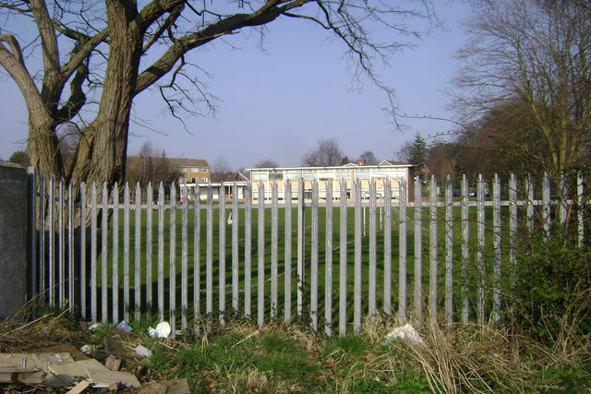
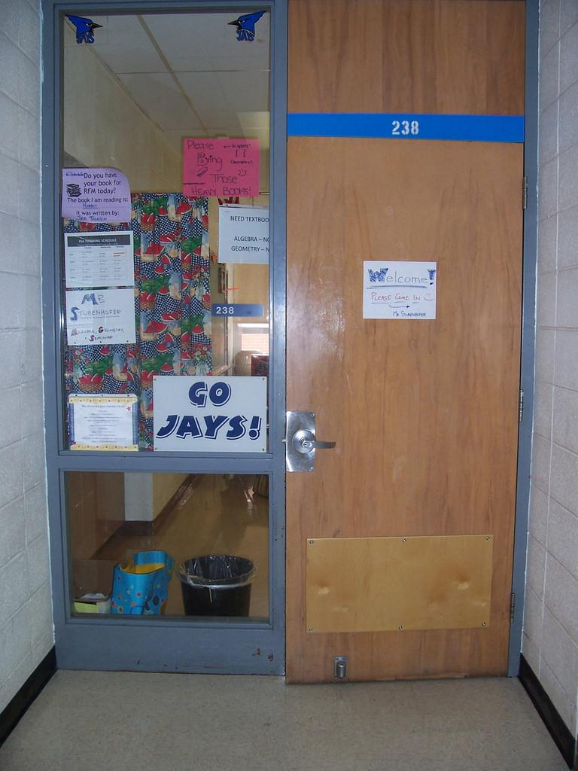
What is Territorial Reinforcement?
TERRITORIAL REINFORCEMENT:
focuses on the importance of having areas clearly defined so that public, private and semi-private areas are obvious.
Examples:
Fences define the school boundary and this area is public
Classrooms are semi-private.
The Principal’s office is private.

Slide 5
YOUR TURN:
Apply the principle of Territorial Reinforcement.
INVESTIGATION STARTER (10 minutes)
How do lines control what we do?
What is the effect of lines:
on our courts?
on our school driveway?
in our car park?
What other materials are used to define areas in our school?
How are areas for staff and students defined?
How are out of bounds areas defined?
Then CHECKLIST and PHOTOS (15-30 minutes)

