Slide 1
SAFER SCHOOLS
Session 2
Notes:
Version 1.2

Slide 2
REVIEW: NATURAL SURVEILLANCE
NS in an environment allows people to see and be seen.
NS deters crime because people do not want to be seen committing offences.
NS can be improved by:
using materials that people can see through
designing environments where people have clear sightlines
encouraging people to use the environment so there are more people seeing what is happening in that environment.

Slide 3
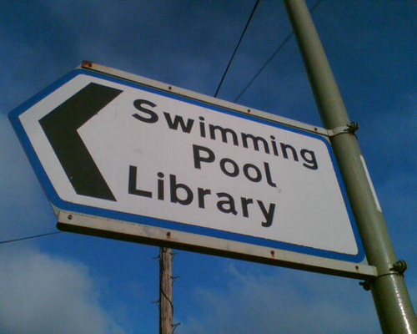
What is ACCESS MANAGEMENT?
ACCESS MANAGEMENT:
focuses on clear, direct walkways and clear signage
deters crime because it reduces the possibility of offenders making excuses for where they shouldn’t be.

Slide 4
YOUR TURN:
Apply the principle of access management.
INVESTIGATION STARTER (10 minutes)
How easy it is for visitors to find their way from our school’s front gate:
to the front office of the school
to the hall
to the library
to our classroom?
Where do the pathways lead?
Is the signage clear?
Then CHECKLIST and PHOTOS (15-30 minutes)

