Slide 1
SAFER SCHOOLS
Session 1

Slide 2
How does the environment affect our safety?
Learning intentions:
Identify examples of the principle of natural surveillance within our school.
Explain how we can use the principle of natural surveillance to improve safety at our school.

Slide 3
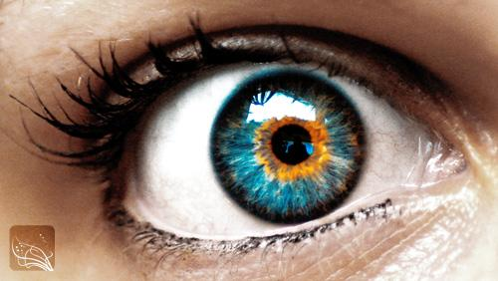
What is Natural Surveillance?
NS in an environment allows people to see and be seen.
NS deters crime because people do not want to be seen committing offences.
NS can be improved by:
using materials that people can see through
designing environments where people have clear sightlines
encouraging people to use the environment so there are more people seeing what is happening in that environment.

Slide 4
YOUR TURN:
Apply the principle of NS to the photos of a burglary in a school.
What has happened?
Where has this happened?
How has the offender gained entry into the room?
What has helped the offender to commit the crime?
What could have prevented this crime?
What features would have helped to prevent this crime?

Slide 5
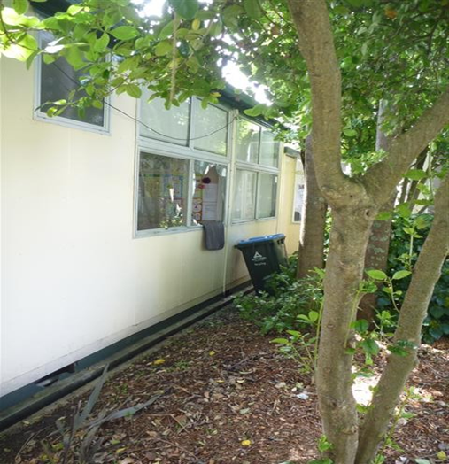
What has happened?
Where has this happened?
How has the offender gained entry into the room?
What has helped the offender to commit the crime?

Slide 6
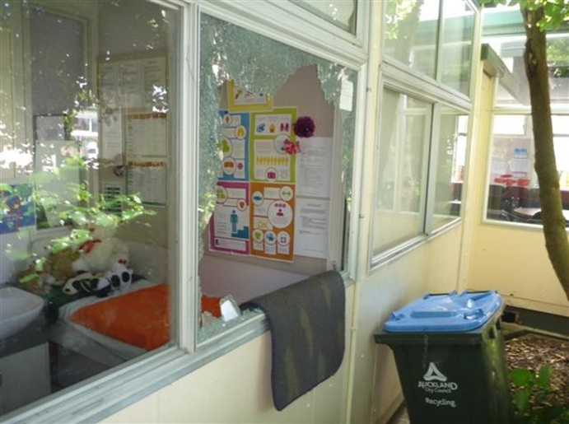
How has the offender gained entry into the room?
What has helped the offender to commit the crime?
What could have prevented this crime?

Slide 7
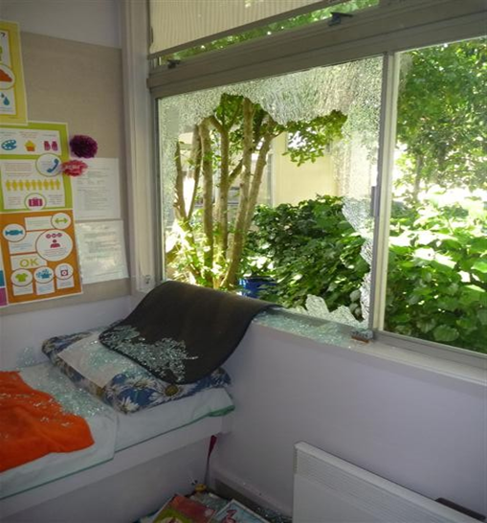
How has the offender gained entry into the room?
What has helped the offender to commit the crime?
What could have prevented this crime?

Slide 8
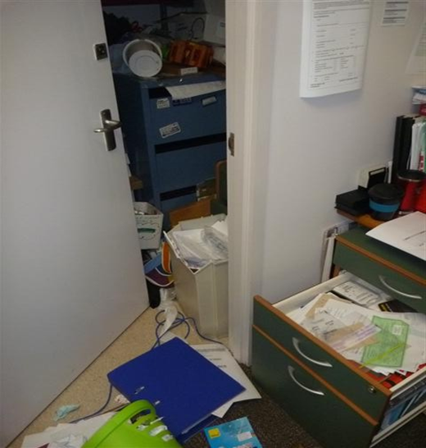
How has the offender gained entry into the room?
What has helped the offender to commit the crime?

Slide 9
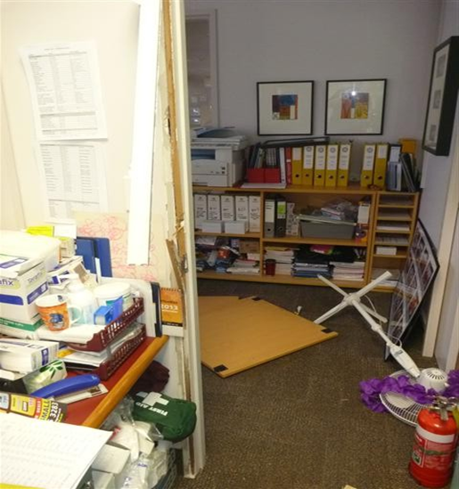
What has happened?
Where has this happened?
How has the offender gained entry into the room?
What has helped the offender to commit the crime?
What could have prevented this crime?

Slide 10
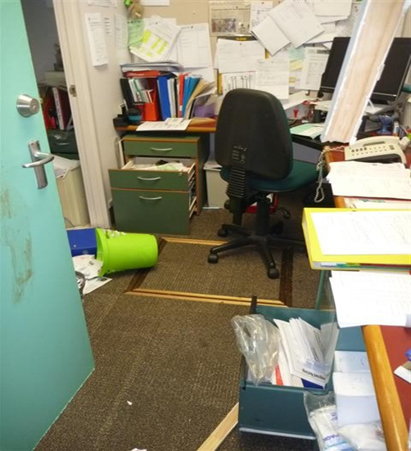
What has happened?
Where has this happened?
How has the offender gained entry into the room?
What has helped the offender to commit the crime?
What could have prevented this crime?

Slide 11
Identify ways in which a burglar could enter our classroom after hours.
What items in our class could be valuable to an offender?
Why could they be valuable?
How are these items protected during school hours?
How are these items protected after hours?

Slide 12
15 minutes to...
Identify elements of Natural
Surveillance.
In groups of 4 do a speedy circuit around our school and photograph EVIDENCE of:
open lines of sight, e.g. see through fences & wind-breaks
foliage that doesn’t provide hiding places, e.g no shrubs and lower branches of trees are cut off
lighting, e.g. sensor lighting
internal glass walls
neighbours who can watch and can report suspicious behaviour
community groups who use school facilities after hours
community safety organisations, e.g. community patrol checks, neighbourhood support, security company patrols
passing vehicular & foot traffic who can report suspicious behaviour.
Allocate group roles: LEADER, time keeper, photographer. You are all IDEA generators!

Slide 13
What about us?
Applying what we have learned to our classroom.
Where is there good natural surveillance?
Where is there poor natural surveillance?
How visible are the valuables in our classroom?
What can people see from the outside looking in?
How could we limit visibility into our classroom after school hours?

