Slide 1
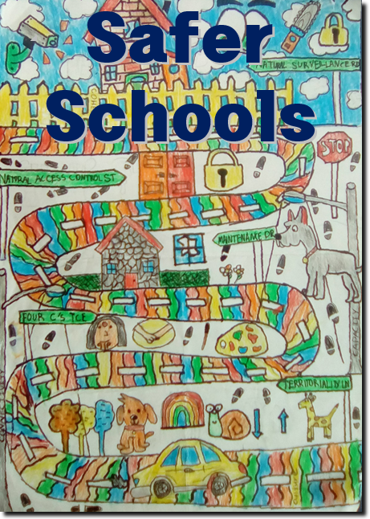
Notes:
Version 1.2

Slide 2
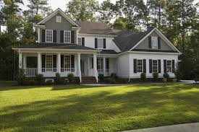
Four physical principles
Territorial Reinforcement - who belongs here?
Natural Surveillance -what can you see?
Access Management - where do you go?
Quality Environments - who owns this place?

Slide 3
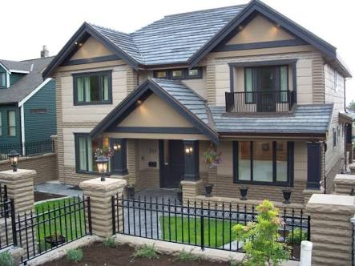
1. Territorial Reinforcement
Defining spaces
Private, semi-public and public areas

Slide 4
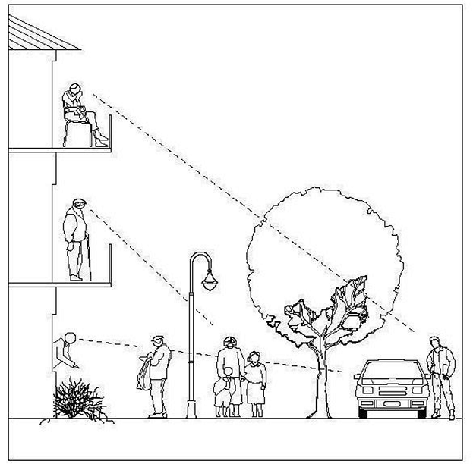
2. Natural Surveillance
To see and be seen
Using different levels, lighting, materials

Slide 5
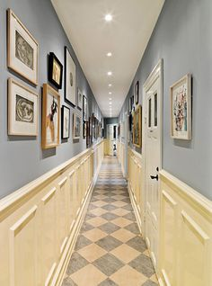
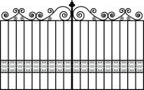
3. Access Management
Clear signage/directions
Wide doors / pathways / stairs
Controlling who goes in/out
Watch for entrapment sites

Slide 6
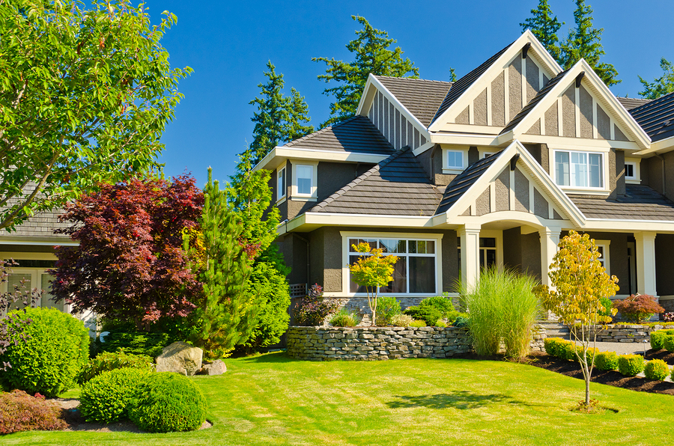
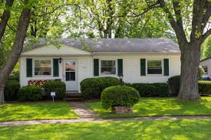
4. Quality Environments
Shows that people care
Lawns mowed, houses painted
Message that crime will not be tolerated

Slide 7
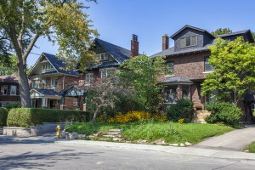
Auditing your area
Walk around your school.
Become familiar with all areas of your school.
Enlarge an A4 map of your school to an A3 size by hand.

Slide 8
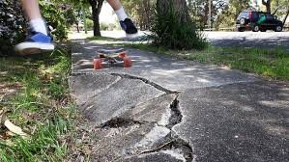
Colour-coding your school map
Use green, orange or red to colour-code areas on your map.
= Safe
= Needs improving
= Unsafe

Slide 9
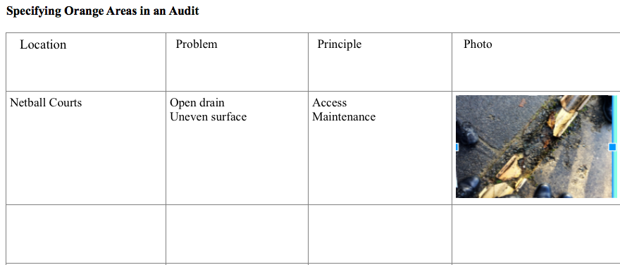
Specify areas that need improving

Slide 10
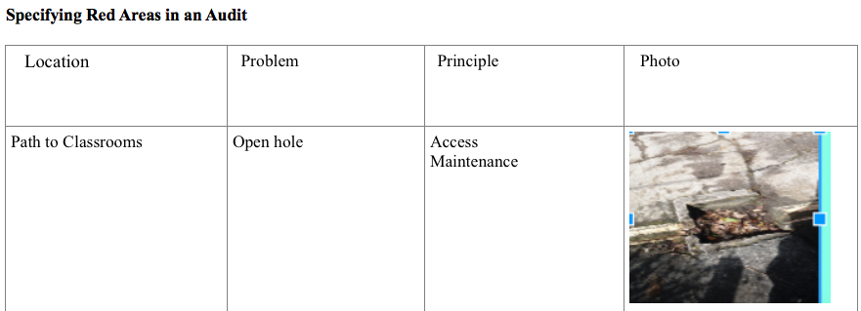
Specify areas that are unsafe
Notes:
Jessica X & Grace

Slide 11
Grade red areas to identify urgent needs
‘1’ means it’s not that important to fix it.
‘2’ means it’s important to fix it, but it’s not urgent.
‘3’ means you need to fix it straight away.
These become your recommendations.

Slide 12
Recommendations

Slide 13
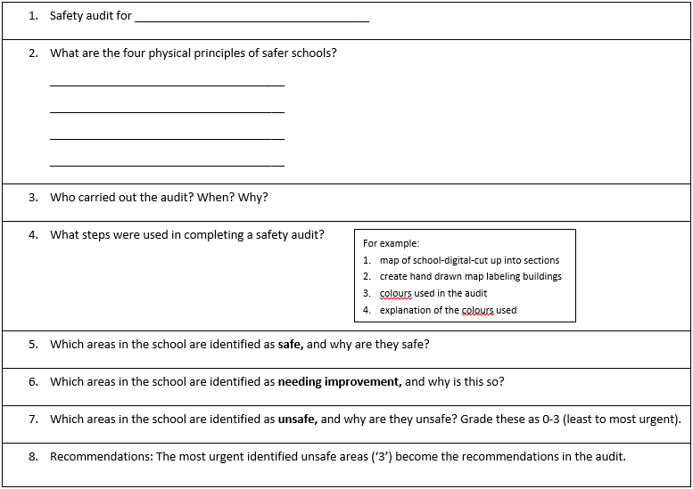
Write up audit findings to present to BoT or community

Slide 14
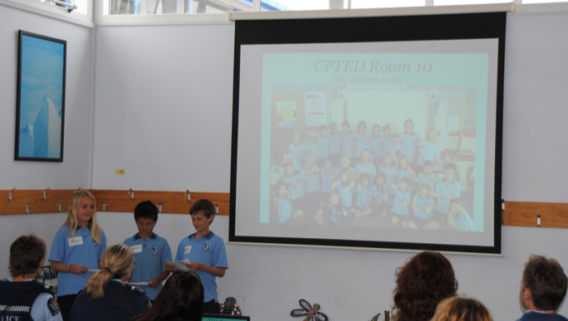
Present findings to the BoT or community

