Slide 1
Maori and Family Harm

Slide 2
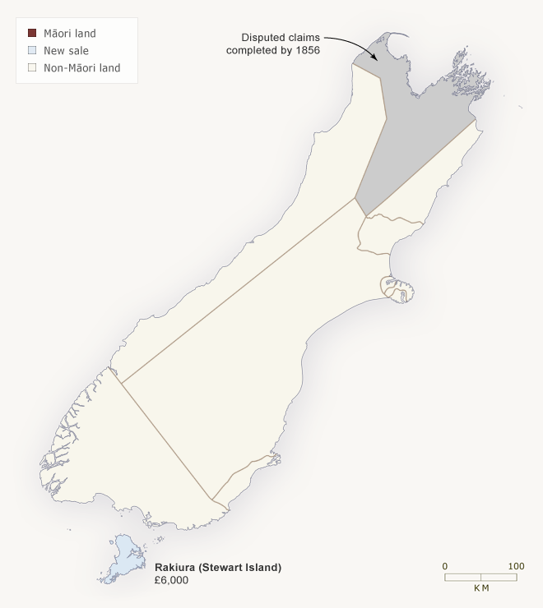
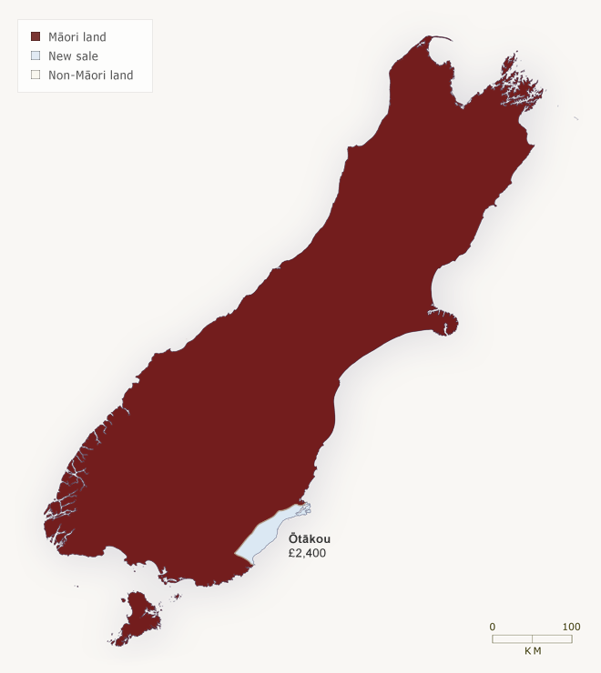
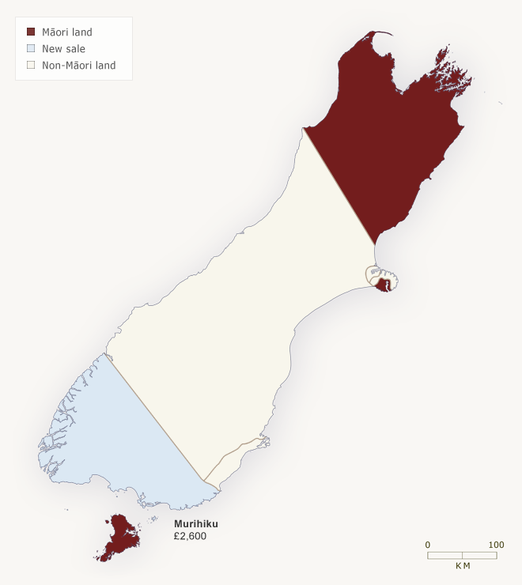
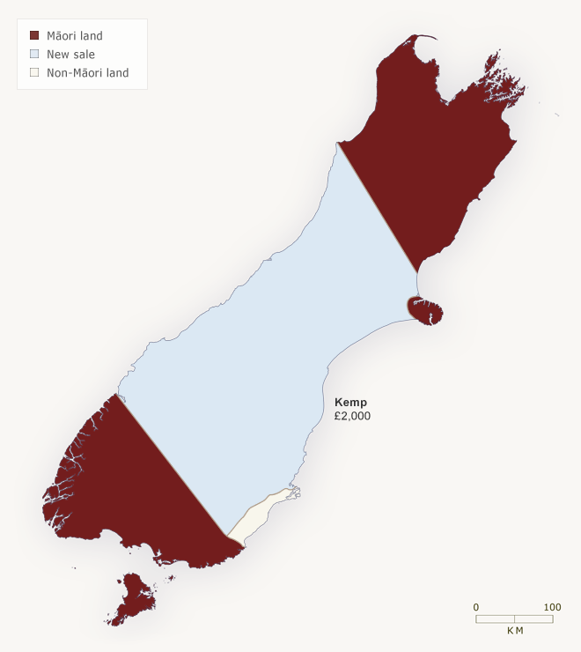
COLONISATION…DESTABILISING A CULTURE
1910: Māori hold 27%
1890: Māori hold 40%
1860: Māori hold 80%
Land wars – 1845-1872
1853- Official crime stats start being published annually
1844: Māori hold all but Otakou
1848: Māori hold <50%
1853: Māori hold <30%
1864: Māori hold 0%
Native Land Act 1862
Suppression of Rebellion Act 1863
NZ Settlement Act 1863
Disturbed Districts Act 1869
1867 – Native Schools Act
Māori Prisoners’ Trial Act 1879
West Coast Settlement (North Island) Act 1880
1909 – The Native Land Act
Reference: Adapted from internal Police workshops delivered by Dr Simone Bull based on her (2001) Doctor of Philosophy in Criminology, Victoria University of Wellington, New Zealand. “The land of murder, cannibalism, and all kinds of atrocious crimes? An Overview of ‘Maori Crime’ from Pre-Colonial Times to the Present Day” - as well as - Bull, S. J. (2004) “The land of murder, cannibalism, and all kinds of atrocious crimes? Maori and Crime in New Zealand, 1853-1919” British Journal of Criminology, Vol. 44, July, pp. 496-519.

Slide 3
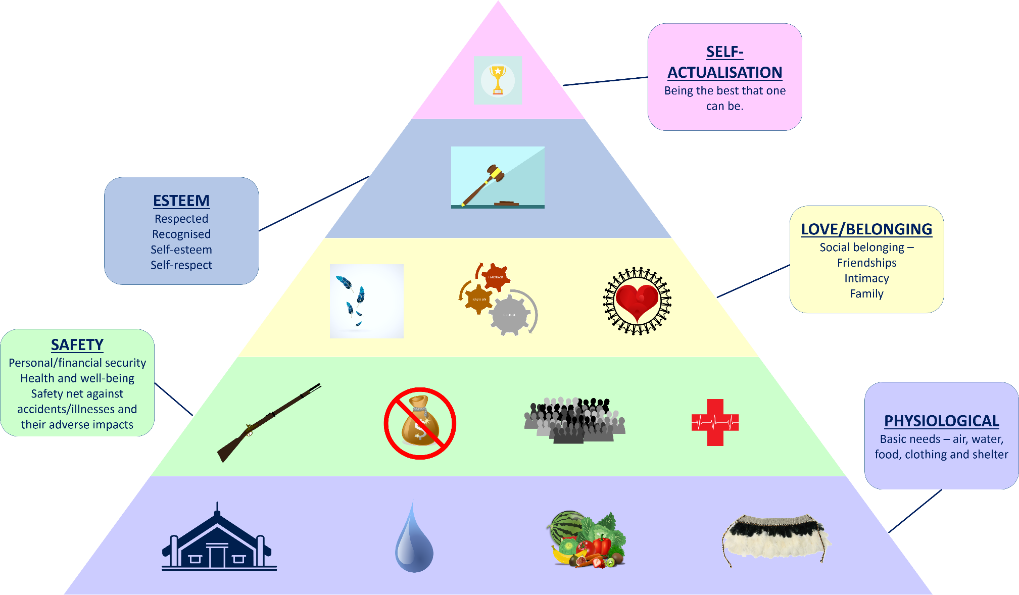
Given what you have just learnt about colonisation, do you believe Māori have their needs met in keeping with Maslow’s Hierarchy of Needs?
MASLOW’S HIERARCHY OF NEEDS
Reference: adapted from Maslow’s Hierarchy of Needs

Slide 4
URBANISATION…DESTABILISING A SOCIETY
1939: Māori hold 9%
The Manpower Act 1944
By 2000 Māori hold 4%
Post-war migration
Urban relocation programme
Māori housing – pepper-potting
Adapting to city life
Reference: Adapted from internal Police workshops delivered by Dr Simone Bull based on her (2001) Doctor of Philosophy in Criminology, Victoria University of Wellington, New Zealand. “The land of murder, cannibalism, and all kinds of atrocious crimes? An Overview of ‘Maori Crime’ from Pre-Colonial Times to the Present Day” - as well as - Bull, S. J. (2004) “The land of murder, cannibalism, and all kinds of atrocious crimes? Maori and Crime in New Zealand, 1853-1919” British Journal of Criminology, Vol. 44, July, pp. 496-519.

Slide 5
MĀORI AND FAMILY HARM

Slide 6
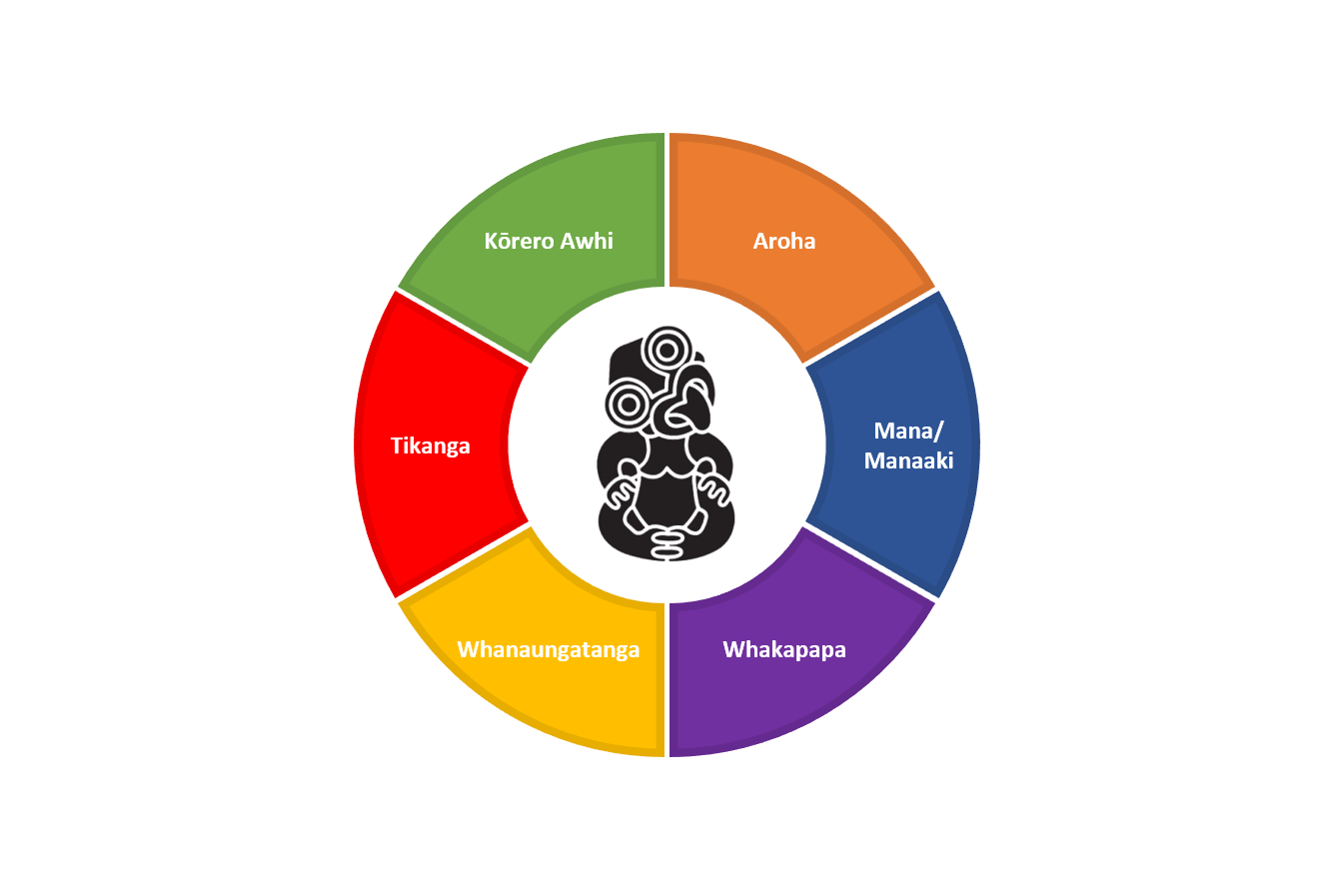
TIKANGA VALUES
Open communication, being supportive.
Giving with no expectation of return.
Doing things the right way, according to our values.
Building the mana of others, through nurturing, growing and challenging.
It’s about being connected.
Knowing who you are and where you belong
wHĀNAU HARM IS NOT TIKANGA
Reference: E Tū Whānau! Te Mana Kaha o te Whānau. Retrieved November 2017 from http://etuwhanau.org.nz/our-values/

