Slide 1
A healthy relationships workshop
2021

Slide 2
0.1
New Zealand’s high rates
15-19 year olds have the highest rates of intimate partner violence in New Zealand:
15%
of 12-18 year olds (20% of females, 9% of males) reported having experienced unwanted sexual behaviour in the
past year.
29%
of 15-19 year olds reported being hit or harmed by another person in the previous year.
21%
of women who stayed in Women’s Refuges were aged 15 to 19.
Source: Beres, M. (2017). Preventing adolescent relationship abuse and promoting healthy relationships. Auckland, New Zealand: New Zealand Family Violence Clearinghouse, University of Auckland.
Notes:
Note: These statistics are taken from Beres, M. (2017). ‘Preventing adolescent relationship abuse and promoting healthy relationships’. Auckland, New Zealand: New Zealand Family Violence Clearinghouse, University of Auckland. https://nzfvc.org.nz/issues-paper-12-preventing-adolescent-relationship-abuse

Slide 3
0.2
Key messages for today…
Everyone deserves to have healthy, positive relationships
There are strategies you can use to help make this a reality

Slide 4
0.3
A workshop in 5 sections
1.
Understanding consent
2.
Unhealthy relationships
3.
Building positive relationships
4.
Stepping in
5.
Be an agent of change!

Slide 5
0.4
As you make your way to the classroom, think about a time when you felt challenged in a relationship, and a time when you felt good in one.

Slide 6
Establishing whanaungatanga and kaupapa

Slide 7
0.5
Introductions
Meet your facilitators for today.

Slide 8
0.6
Where in the world?
Write on a piece of paper where you are from.
Holding the paper, walk around the room and find someone who comes from somewhere far away from where you are from.
Talk to each other about the places.
Find at least one connection between the places and your story.

Slide 9
0.7
Where in the world?
What helped me feel good in that activity?
What was hard for me in that activity?
If I did it again, what would I keep and what would I change?

Slide 10
0.8
Reflection
What I hope to get from today is ...

Slide 11
Understanding consent
Notes:
Focus area 1

Slide 12
1.1
If you can’t view the embedded video on the slide use the link below (opens in another window): https://www.youtube.com/watch?v=vnM83Cp0kQ8

Slide 13
1.2
Defining consent
1.
What is consent?
2.
How do we know when consent has been given or not given?
3.
What strategies can we use to give or not give consent?

Slide 14
1.3
Consent scenarios
In your group, read and discuss the scenarios you have.
Has consent been given? How you know?
What are the implications?
Emotional
Physical
Legal

Slide 15
1.4
Consent scenarios discussion
Was consent given? How do you know?
What might the emotional, physical, and legal impacts be on the people involved?

Slide 16
1.5
Consent scenarios discussion
What options does a person who hasn’t given consent have?
Imagine being the person who didn’t ask for consent: what could they do differently?

Slide 17
1.6
Consent and tea
If you can’t view the embedded video on the slide, use the link below (opens in browser window): https://youtu.be/fGoWLWS4-kU
Notes:
COULD activity

Slide 18
1.7
Reflection
The things I have learned about consent are ...

Slide 19
Unhealthy relationships
Notes:
Focus area 2

Slide 20
2.1
Minimisation
and blame
Intimidation
Possessiveness
Sexual abuse
Power
and
control
Humiliation
Physical abuse
Domination
Threats

Slide 21
Minimisation
and blame
Intimidation
2.2
1
3
Possessiveness
Honeymoon
or remorse
Sexual abuse
Explosion
Cycle of abuse
Humiliation
Physical abuse
2
Domination
Threats
Tension building

Slide 22
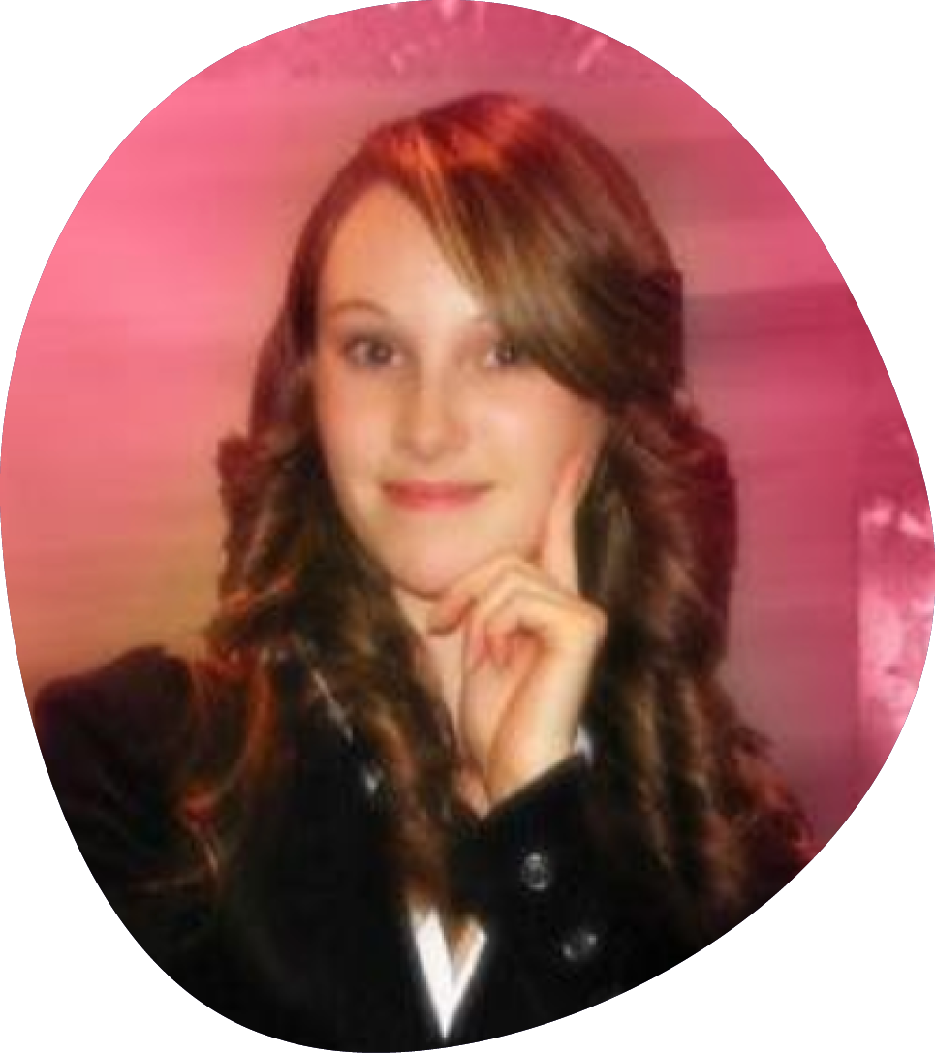
2.3
Sophie Elliott
22 years old
Economics student at Otago University
Just got a job in Wellington
Five-month relationship with Clayton
Killed in her home 2008

Slide 23
2.4
If you can’t view the embedded video on the slide, use the link below (opens in browser window): https://youtu.be/rtbXlVyNZqs

Slide 24
2.5
Unpacking Sophie’s story
What did you notice about:
Power and control behaviours
The cycle of abuse
Challenges the bystanders faced

Slide 25
2.6
Reflection
What would you have done as a bystander in Sophie’s situation?

Slide 26
Building positive relationships
Notes:
Focus area 3

Slide 27
3.1
Honesty and responsibility
Open communication
Trust and support
Intimacy
Equality
Respect
Physical affection
Fairness and negotiation
Shared responsibilities

Slide 28
3.2
Reflection
To help me have a healthy, positive relationship …
I have the right to expect these things from others:
and
I have the responsibility to do these things for others:

Slide 29
Stepping in
Notes:
Focus area 4

Slide 30
4.1
Stepping in
Was consent given?
What legal implications are there for the abuser?
What actions did the bystanders take that made them active bystanders?

Slide 31
4.2
The Bystanders
If you can’t view the embedded video on the slide, use the link below (opens in browser window): https://youtu.be/mz49UnZSj8c

Slide 32
4.3
Stepping in
Was consent given?
What legal implications are there for the abuser?
What actions did the bystanders take that made them active bystanders?

Slide 33
4.4
AGREE
DISAGREE

Slide 34
4.5
Reflection
The parts of today’s workshop that have been relevant to me are … because ...

Slide 35
Be an agent of change!
Notes:
Focus are 5

Slide 36
5.1
If you can’t view the embedded video on the slide, use the link below (opens in browser window): https://youtu.be/x8-l9YyVpz0

Slide 37
5.2
Ideas for change
What change do you want to make, or make a contribution to?
Is it personal?
Is it in relation to your friends and whānau?
Is it a community or social change?

Slide 38
5.3
Connect with other ideas
1.
Self group based on the ideas you heard
Share with the group your ideas in a bit more depth and why you chose them. “Why” can be a reference to a personal moral value, or being moved by an idea or statistic you heard today, or a personal experience, and so on.
2.
2.

Slide 39
5.4
Refine your plan for action
Use the handout to start planning your idea for action in more detail.

Slide 40
5.5
Reflection
In response to today, when I leave this room, I am going to ...

Slide 41
Wrapping up

Slide 42
6.1
Key learning
What is one thing you’ve learned today?

Slide 43
6.2
Feedback
Please provide honest feedback.
Make sure your feedback has been collected before you leave.

Slide 44
6.3
Thank you

