Slide 1
Important note
This presentation is only a starting point, not a finished product.
Make a copy and adapt it as you need for your workshop with teachers.
There are presentation notes on each slide’s Notes page to help you.
Notes:
This presentation is only a starting point for you, not a finished product. For example, it is too long because we have included absolutely everything for every possible type of teacher presentation. You will therefore need to:
remove this red slide from your copy
add your name where required
remove slides you don’t need for your presentation
delete info about removed slides from the KOS presentation overview slide.
Don’t forget that there are additional presentation notes on each slide’s Notes Page to help you.

Slide 2

Police service to school communities
Teachers meeting presentation
Notes:
Before doing this presentation, ensure you:
view beforehand the school’s child protection policy
have copies of policy available for parents to view following presentation
have copies of Keeping Kids Safer booklet for parents who are new to KOS
discuss with the school who is going to present which part of this presentation
check which parts of the agenda are relevant for your session – remove sections you are not going to do from the agenda (slide 3) and the blue heading slides on this presentation
choose if you wish to keep or leave the slides concerning the KOS resources that your school does not cover
insert your name into the Introduction (slide 2)
invite guests if appropriate
prepare for common questions asked by parents (refer to back of the KOS resources for samples)
discuss with the school what should happen if any audience are upset by the meeting.
Note: The following welcome should be done by someone from the school, for example the KOS Coordinator, the Health Coordinator or the Principal.
WELCOME
Welcome the audience for attending.
Explain why the school has called the meeting.
Outline any housekeeping matters. Ensure this includes what to do if anyone is upset during the meeting.
Hand over to the SCO.

Slide 3
Presentation overview
What is Keeping Ourselves Safe (KOS)?
What do we mean by child abuse?
Why teach KOS?
The whole school approach
Overview of the KOS programme
Dealing with abuse
Where to from here?
Notes:
Explain that Keeping Ourselves Safe is often referred to as KOS.
Explain that through this presentation, we will:
explain what KOS is
ensure we have a common definition of child abuse
discuss why schools need to teach KOS
discuss the whole school approach to KOS
look at an overview of the teaching programme and resources
discuss what to do if abuse is disclosed to us
discuss what our next actions will be to implement KOS in our school.

Slide 4
What is Keeping Ourselves Safe?

Slide 5
What is KOS?
Comprehensive child abuse prevention programme |  | Protects children from all sorts of abuse
 | Years 0-13
Introduced in 1986 |  | Extensively evaluated and revised
Notes:
Ask: “Who has taught KOS before?”
Explain that KOS:
is a comprehensive child abuse prevention programme
goes from junior primary to senior secondary (years 0-13)
was developed in response to an increasing awareness amongst police and teachers of the need to protect children from abuse
was first introduced in schools around 1986 after a requirement to teach safety skills to children
has been extensively evaluated and revised.

Slide 6



Aims of KOS
To teach children a range of safe practices they can use when interacting with other people
To teach students how to recognise the difference between healthy and unhealthy relationships
To make parents and teachers more aware of their responsibilities to help students avoid abuse.
Notes:
6
Explain that the aims of KOS are:
To teach children a range of safe practices that they can use when interacting with other people, both online and face to face
To teach students how to recognise the difference between healthy and unhealthy relationships, and encourage students who have been or are being abused to seek help.
To prevent abuse by making parents and teachers more aware of their responsibilities to help students avoid abuse.

Slide 7
Key concepts
Abuse:
  is unacceptable and a crime
  takes many damaging forms
  is never the victim’s fault.
No-one deserves to be abused.
Everyone is responsible to help prevent abuse.
Continued
Notes:
Explain that:
Abuse is unacceptable and is a crime.
Abuse can take a number of forms and all can be damaging to the victim.
Abuse is never the victim’s fault.
No-one deserves to be abused.
Everyone in schools and the school community has a responsibility to help prevent abuse of children.
… continued on next slide …

Slide 8
Key concepts
Teach children to:
  recognise abuse
  recognise when others need help
  avoid abuse
  report abuse.
Teach adults to listen and act on reports.
Ensure schools have effective abuse policies.
Notes:
… continued from previous slide …
Explain that:
Skills, knowledge and attitudes can be taught that will help children recognise, avoid and report abuse.
Reports of abuse must be listened to and acted on.
Children need abuse prevention education in an ongoing way throughout their schooling.
Schools must have effective abuse prevention policies and procedures in place.
Note - make sure you have:
already viewed the school’s child protection policy
copies are available for staff to view following presentation. It is important that they are familiar with the policy and who to go to if they become aware of abuse.

Slide 9
What do we mean by child abuse?

Slide 10
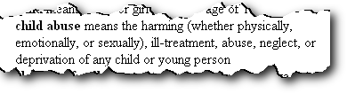
What is child abuse?
What is the definition of child abuse?
Oranga Tamariki Act, 1989 : Section 2
Notes:
Break teachers into groups.
Ask them to come up with a definition of abuse.
Share group definitions.
Click mouse to bring up OT Act definition.
Explain that in KOS, abuse is defined as:
“Abuse occurs when anybody uses power over another person and causes them harm. This could include hurting them physically, ill treating them or failing to take care of their everyday needs, touching them in sexual ways or showing them sexual materials, or hurting their feelings and damaging their sense of well being. It also includes violence that happens within families. Abuse can harm a child’s health, their dignity and may make it hard for them to learn and develop.”

Slide 11
Types of abuse
What are the different types of abuse?
Physical
Sexual
Emotional
Neglect
Cyber abuse
Family harm
Notes:
Ask groups to identify the different main types of abuse.
Share group answers.
Click mouse to bring up the types of abuse covered in KOS:
physical
sexual
emotional
Neglect
cyber abuse
family harm
Optional:
Do Activity 2 from Year 4-6 KOS.

Slide 12
Stranger danger?
‘In the majority of cases the abusers are known and trusted by their victims.’
‘The emphasis on ‘stranger danger’ causes adults to miss the clues that children give when they are being victimised by trusted family friends, professionals or relatives.’
  (Professor Freda Briggs)
Notes:
Quotes from Freda Briggs - Emeritus Professor in child development, researcher and lecturer in sociology, child protection at the University of South Australia, Magill Campus.
Explain that instead of concentrating on the type of person to keep away from (‘stranger danger’), KOS teaches children and young people the behaviours to identify and avoid, whether they are from people known or unknown to them (‘behaviour danger’).
Explain that idea of ‘stranger danger’ was dangerous because:
it made it easier for people who didn’t ‘look like strangers’
it failed to protect from the huge amount of non-stranger abuse
It was confusing because children do have to interact with strangers if they need help etc.

Slide 13
Abuse facts
1 in 4-5 females, and 1 in 6-8 males report unwanted sexual touching
NZ has the fifth worst child abuse record of the 31 OECD countries
On average 1 child is killed every 5 weeks. 90% by someone they knew
Only 8-12% were reported to any organisation
From Oranga Tamariki, quarterly report, December 2019
Notes:
Discuss who abuses children:
Abuse happens in all communities, regardless of their ethnic, socio-economic, geographic and religious make up.
Men and women.
Elderly down to same age as child.
Stranger danger approach not appropriate as the majority of abusers are known to the child.
The statistics in this slide come from 2019.
https://www.orangatamariki.govt.nz/statistics/quarterly-reporting/quarterly-report-december-2019/care-and-protection-statistics-2/
Magnitude of crime type
1 in 4-5 females, and 1 in 6-8 males report unwanted sexual touching (International and national research)
NZ has the fifth worst child abuse record out of 31 OECD Countries
On average 1 child is killed every 5 weeks (most under 5 years old). 90% by someone they knew.
Significant under-reporting
Only 8-12% were reported to any organisation
Connections to later life issues (consequences)
sexualised behaviour
under achievement
substance abuse, health issues
crime relationship (victimised and offending).

Slide 14
Online experiences
Nearly a quarter of 9-17-year-old children surveyed said they had been treated in a hurtful or nasty way – online, offline or both.
Older children (12-17) experienced this online more often that younger children.
Girls experienced this more often, both in person and online, than boys.
From Netsafe, New Zealand children’s experiences of online risks and their perceptions of harm, 2020
Notes:
USE this slide when teachers are keen to understand whether KOS covers cyber safety …
The risks in the online world are real but children can learn to act safely in that world and behave as responsible digital citizens.
The online world is as much part of life today as the physical world, and it is not going away.
While KOS is not primarily a cyber safety programme, the competencies children develop throughout the programme will help them in both the physical and online worlds.
Netsafe: survey of children aged 9-17 : New Zealand children’s experiences of online risks and their perceptions of harm
https://www.netsafe.org.nz/wp-content/uploads/2020/02/Ng%C4%81taiohimatihikooAotearoaNZchildrensexperiencesofonlinerisksandharm.pdf
Some summary findings:
Nearly a quarter of all 9-17-year-old children said they had been treated in a hurtful or nasty way either online or offline or both.
Online hurtful behaviour was more commonly experienced by older children (12-17).
1 in 4 New Zealand children (9-17 years old) said that they had been bothered or upset by something that happened online in the last year.
Nearly half of teens (13-17) said they were exposed to at least one of the six different types of potentially harmful online content the survey asked about.

Slide 15
Why teach KOS?

Slide 16
Why should schools be concerned?
School should be a safe place for children and staff.
Teachers are concerned about the welfare of children.
Children can’t learn if their physical and emotional needs are not met.
Digital technologies can bring risks.
Children may disclose abuse to people at school.
Notes:
Explain that schools need to consider that:
schools need to provide safe physical and emotional environments for students (refer to NAG5 – National Administration Guideline 5)
teachers are often concerned over the welfare of students
students cannot begin to learn if their physical and emotional needs are not being met – a child who is abused is less likely to achieve their full potential as an individual, and may struggle to focus on leanring
the use of digital technologies for learning and communication may expose students to risk
students may disclose to another student or any member of the school staff (teaching or non-teaching) whom they trust.

Slide 17
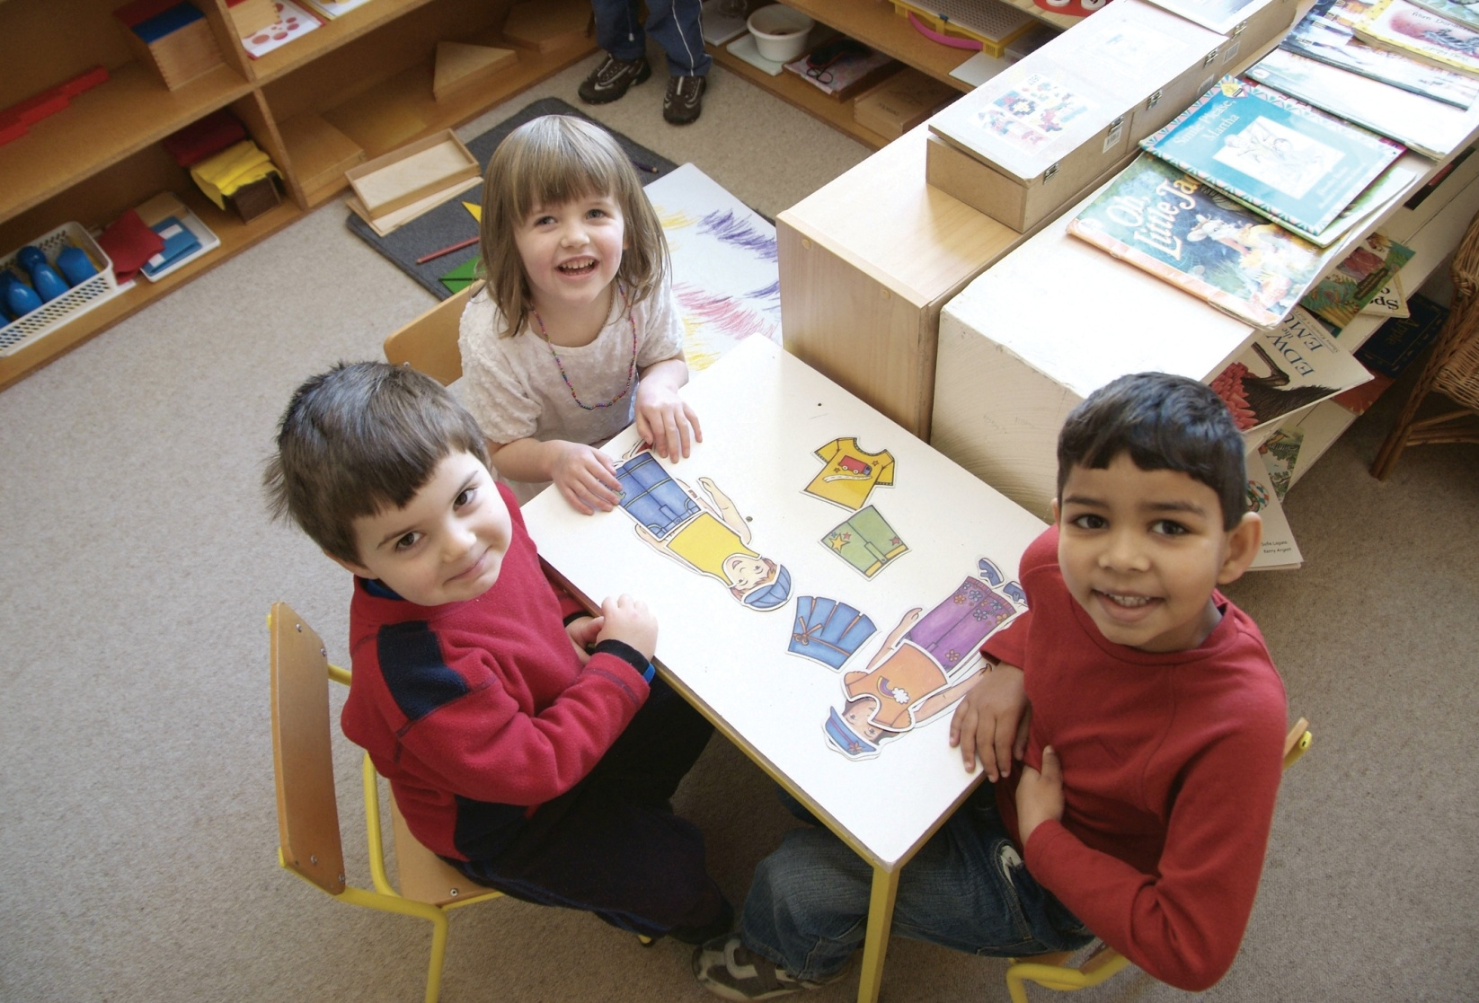
Why teach KOS?
Increasing need to learn to interact safely with other people, both online and face-to-face, and to have strategies to use should problems arise.
Notes:
Explain that:
In today’s world, children have an increasing need to learn, develop and practise a variety of personal skills to help them keep themselves safe in a variety of situations.
They need to learn to interact safely with other people, both online and face-to-face.
They need strategies to use should problems arise.
Explain that:
Commonly used parenting styles make children vulnerable to sexual predators (for example, keeping secrets, always doing what you're told).
Parents often don’t teach safety skills in the best way
Children who have completed a child abuse prevention programme are more likely to tell someone if abuse is taking place or when abuse begins
Research shows that the earlier a child receives abuse prevention education, the greater the likelihood that it can be stopped or (even better) not allowed to start.
KOS is not only about sexual abuse and it is definitely not sex education.

Slide 18
The whole school approach

Slide 19
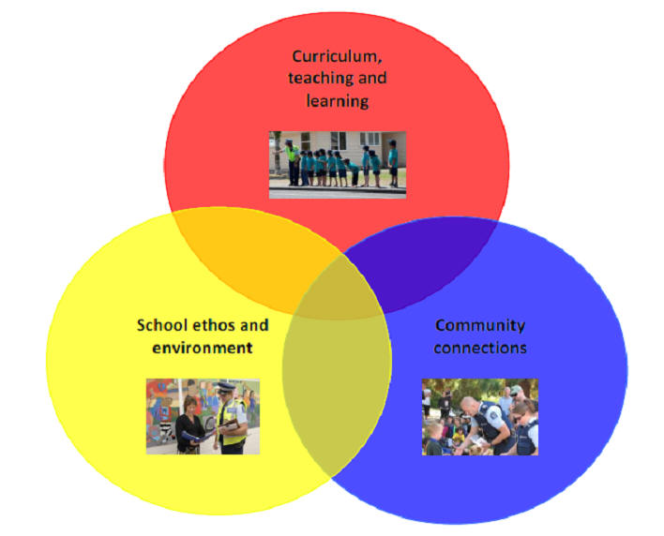
Whole school approach
Notes:
Introduce the internationally recognised term ‘whole school approach’.
As described in the Intervention planning tool available from the Police’s Schools portal

Slide 20
Whole school approach
Safety and wellbeing values endorsed by the whole school community.
Shared understanding of abuse.
Sound child protection policies.
Fair and consistent method of dealing with safety and wellbeing issues.
Positive safe behaviours are modelled and supported.
Continued
Notes:
Introduce the internationally recognised term ‘whole school approach’.
Explain that the key elements of a whole school approach with regard to child protection are: :
An agreed set of values relating to safety and wellbeing that the whole school community endorses, including students, teachers, principals, boards of trustees, primary caregivers and the wider community.
A shared understanding of all forms of abuse.
Sound child protection policies and procedures are developed, applied, and reviewed regularly.
Fair and consistent methods of dealing with situations when safety and wellbeing are compromised.
Positive, safe behaviours are modelled and supported.
… continued on next slide …

Slide 21
Whole school approach
Safe, supportive classrooms.
Teaching integrated through whole school.
Students/staff feel able to disclose abuse.
Specialist help and training.
Regular evaluation.
Programme becomes self-sustaining.
Notes:
… continued from previous slide …
Explain that more key elements of a whole school approach with regard to child protection are:
The creation of safe, supportive classrooms.
The KOS teaching programme is integrated throughout the school.
Members of the school community feel able to disclose abuse.
Specialist help and training is available, for example social worker or public health nurse.
Evaluation is carried out regularly.
The KOS programme becomes self sustaining within the school, and police involvement is not required every time the school implements the programme.

Slide 22
Self-sustained KOS
School takes ownership of KOS.
Principal appoints a KOS coordinator.
School consults with community.
Teachers plan and teach the lessons
School evaluates the programme.
Notes:
Explain that it is essential for the whole school approach for KOS to become self-sustaining.
This means:
the school takes ownership of the programme
the principal appoints a designated KOS coordinator to manage the programme
the school takes responsibility for consulting with the community about KOS
teachers plan and teach the bulk of the lessons
the SCO may partnership teach up to 3 lessons
the school ensures the KOS programme resources are available and complete
the school evaluates the programme.

Slide 23
Overview of the KOS programme

Slide 24
Information on KOS
All the KOS programme materials are available on the NZ Police website police.govt.nz – search for Keeping Ourselves Safe
Notes:
Point out that
all the programme materials can be found on the NZ Police website, police.govt.nz
the easiest way to find them is to use the search function on the website
there is a page of information and FAQs specifically for parents
schools should check the website each time they use the programme for updated materials.

Slide 25
KOS within the NZC
Health and physical education:
mental health key learning area
  Strand A – Personal health and physical development
  Strand C – Relationships with other people
Key competencies:
managing self
relating to others
participating and contributing
Notes:
25
Explain that KOS:
will support children in the continued development of their key competencies
is a stand alone programme with specific content that fits within the Health and Physical Education learning area
contains more detail on the links with the New Zealand Curriculum within each teaching guide.
Summarise that KOS fits within Health and Physical Education under the Mental Health key learning area:
Strand A – Personal Health and Physical Development
Strand C – Relationships with Other People.
Explain that KOS particularly supports the key competencies of:
managing self
relating to others
participating and contributing.

Slide 26

Teaching programme
Junior primary
Middle primary
Senior primary
Secondary, years 9-10
Secondary, years 11-13
Notes:
26
Explain that:
KOS is able to be taught throughout a student’s entire schooling from Year 0-13.
In the first three years of schooling, students do some KOS activities each year.
The junior primary and middle primary programmes both include key Learning Experiences that should be done each year
The senior primary can be run in a 2 year cycle.
Point out that
the materials can be downloaded from the NZ Police website, police.govt.nz
the easiest way to find them is to use the search function on the website
the programme materials are regularly revised so schools should check the website each year for updates.

Slide 27

Junior Primary
I am unique
My body is my own
Dealing with unwanted touch and behaviour
Adults who help
He taonga ahau
Nōku tōku tinana
Kore e hiahitia te whanonga me te pā kino
Ngā kaiāwhina pakeke
Confident kids say “no”
Notes:
Explain that each of the programmes has a learning sequence and integrity.
While there is flexibility in the programme, teachers must respect this integrity so that students don’t miss out on important knowledge and competency development.
Refer to focus areas:
I am unique
Who we are
How we feel
My body is my own
Physically me (naming parts of body) – explain why we use proper names eg penis, vagina
Touch
Dealing with unwanted touch and behaviour
Saying “no”
Secrets and tricks
Adults who help
Asking people we trust for help
Safety rules

Slide 28

Middle Primary
Confident me
Safe or unsafe?
No excuse for abuse
Why should I tell?
Notes:
Refer to focus areas:
Confident me
About me
I can decide
Safe or unsafe?
The real world
The digital world
No excuse for abuse
About abuse
Bribes, secrets and tricks
Why should I tell?
Getting help
What now?

Slide 29
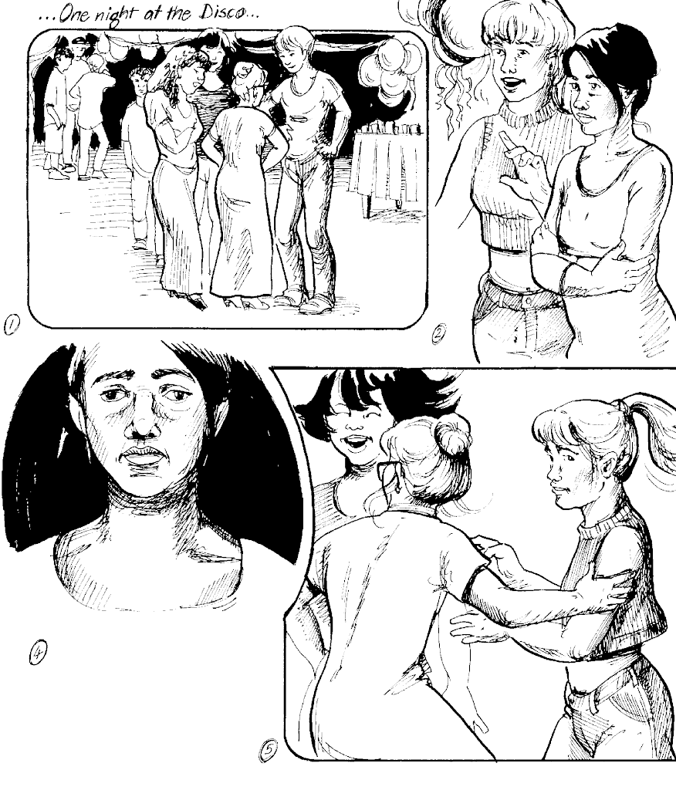
Senior primary
Keeping one step ahead
I’m responsible for others too
Finding out about abuse
Families working together
Reporting abuse
What happens now?
Notes:
Refer to focus areas:
Keeping one step ahead
Choosing safe options
Role playing
I’m responsible for others too
Bullying
Caring for others
Finding out about abuse
Identifying abuse
Feelings about abuse
Responding to abuse
Families working together
Family discipline
Family stress
Reporting abuse
Deciding what to do
Reporting abuse
What happens now?
What happens after I tell?
Sharing new knowledge

Slide 30
Years 9-10 and years 11-13
Core health module
  Identifying abuse
  Recognising and avoiding abuse
  Knowing what to do
  Getting help
Activity bank
  20 activities for years 9-10, 11-13 and transition.
Notes:
Explain that it has
core health modules for years 9-10 and 11-13
an activity bank.
Explain that the activity bank:
contains 20 activities
can be used in a variety of ways and at different times by the school, to ensure that KOS is regularly and consistently presented throughout the year.
Suggestions for use:
Delivered by form or home group teachers in form time.
Delivered by subject teachers as part of the curriculum.
Delivered by Health co-ordinator in partnership with subject teacher.
Delivered by Guidance Counsellors or Deans in partnership with teachers.
Delivered by peer or associate leaders, supported by teachers.
Delivered by SCOs in partnership with teachers.
Year 13 students facilitate activities with Years 9-10.
As a special KOS lesson taught across all classes at one time with the teacher who usually takes the class at that time.

Slide 31
Dealing with abuse
Notes:
Note - the following slides refer to the Step 4 Professional Development Workshop.
Do not use these slides if the school has a separate Step 4 Professional Development Workshop scheduled.
Use these slides if the school is having a merged Step 3/Step 4 meeting.

Slide 32
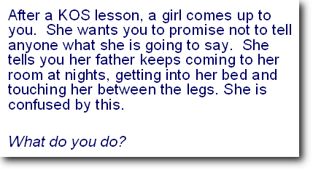
Scenario
Notes:
Note - the following slides refer to the Step 4 Professional Development Workshop.
Do not use these slides if the school has a separate Step 4 Professional Development Workshop scheduled.
Use these slides if the school is having a merged Step 3/Step 4 meeting.
Activity 1
Get groups to consider the scenario and share their responses.
Activity 2
Ask if anyone has had any disclosures made to them at school – could get them to tell group about it – ie how they felt, what they did etc (without too much detail)
Optional activity:
Note - use this activity with caution – you have to be certain of your audience, but it can show how hard it is for children to disclose.
Ask group to get themselves into pairs with someone they don’t know very well. Turn and face their partner and put their knees close together.
Ask them to tell their partner about their last sexual experience. Tell them that they have five minutes.
Note: you will get some very interesting looks from this exercise.
Give them only a few seconds (most will not be willing to talk on topic) then stop them.
Ask for reaction to this activity – explain how when a child is making a disclosure it can be very hard, just like this activity. We don’t often talk about personal experiences like this.

Slide 33
Dealing with disclosures
Ensure the safety of the child
Listen
Believe
Say
Keep calm
Document
Keep the child safe
Follow your school policy
Find support for yourself
Notes:
Note - prior to this presentation obtain a copy of the school policy/procedures for reporting abuse. Ensure the school has copies to hand out to staff.
Refer to the KOS implementation guide.
Explain the following steps:
Ensure the safety of the child
If the child is in immediate danger or unsafe, act immediately to secure their safety.
Do not alert the alleged abuser.
Listen
Do not ask leading questions or put words into the child’s mouth.
Allow them to tell you as much as they want.
Believe
Believe what they say, don’t criticise.
Say
“I’m glad you told me.”
“I’m sorry this happened.”
“It’s not your fault.”
“I’ll do something to help.”
Keep calm
If the child detects your discomfort or anxiety they may not want to share any more of their problem.
Document
Record the day, date and time.
Record what the child has said word for word as far as possible.
Do this as soon as you can.
Keep the child safe
Keep the child in a safe place.
Follow your school policy
It will have practical procedures for you to follow, such as whose support you should enlist.
Respect confidentiality.
Find support for yourself
You may need to have access to an employee support programme or similar.
It is unwise to talk to other staff because of the integrity of the evidence.

Slide 34
Reporting abuse
If you believe that any child has been or is likely to be harmed, ill-treated, abused, neglected or deprived, you should report this.
The most important consideration is always the safety and well being of the child.
Anyone may report to a social worker or member of the Police.
Notes:
Refer to school’s Child Protection Policy
A suspicion is enough because intuition and gut feelings are usually right.
You are not required to have proof – this is the job of the authorities.
It is especially hard to report abuse if you know the family well and find it hard to believe that a child in that family could be maltreated.
Oranga Tamariki Act 1989 states that anyone who believes a child or young person has been or is likely to be harmed, ill-treated, abused, neglected or deprived may report the matter to a social worker or a member of Police. They will be protected providing the information is given in good faith.

Slide 35
Where does our school go to from here?
Notes:
Facilitate a discussion with the staff as to what the next steps will be for them.
If this is a Step 3 KOS presentation to school staff, the next steps may be:
setting up a staff/student support team
organising the Step 4 Professional Development Workshop
planning the succeeding implementation steps.
If this is a combined Step 3 KOS presentation to school staff and Step 4 professional development workshop, the next steps may well be:
reviewing policies such as child abuse, allegations against staff, harassment and bullying.
ensuring all staff are familiar with these policies
ensuring all staff know what to do in the event of a disclosure.
planning the succeeding implementation steps.
Allow time for questions.

