Slide 1
Important note
This PowerPoint is only a starting point, not a finished product.
Make a copy and adapt it as you need for your workshop with teachers.
There are presentation notes on each slide’s Notes page to help you.

Slide 2

Police service to school communities
Parents meeting presentation
Notes:
Before doing this presentation, ensure you:
view beforehand the school’s child protection policy
have copies of policy available for parents to view following presentation
have copies of Keeping Kids Safer booklet for parents who are new to KOS
discuss with the school who is going to present which part of this presentation
check which parts of the agenda are relevant for your session – remove sections you are not going to do from the agenda (slide 3) and the blue heading slides on this presentation
choose if you wish to keep or leave the slides concerning the KOS resources that your school does not cover
insert your name into the Introduction (slide 2)
invite guests if appropriate
prepare for common questions asked by parents (refer to back of the KOS resources for samples)
discuss with the school what should happen if any audience are upset by the meeting.
Note: The following welcome should be done by someone from the school, for example the KOS Coordinator, the Health Coordinator or the Principal.
WELCOME
Welcome the audience for attending.
Explain why the school has called the meeting.
Outline any housekeeping matters. Ensure this includes what to do if anyone is upset during the meeting.
Hand over to the SCO.

Slide 3
Introductions
Constable …………………….
School Community Officer (SCO)
Keeping Ourselves Safe (KOS)
Notes:
Note: Insert your name into this slide.
Introduce yourself by name and talk a little about your general role as a SCO.
Explain that
you come to the school to teach lots of different topics, including road safety.
Fire officers come to teach fire safety.
At school the children learn water safety.
We are here today to talk about another kind of safety programme – personal safety – called Keeping Ourselves Safe, or KOS for short.

Slide 4
Agenda
What is Keeping Ourselves Safe?
Overview of the teaching programme
SCO’s role
Parent / caregiver / whānau role
About abuse (optional)
Questions and answers
Memorandum of understanding (if applicable)
Notes:
Note: Adapt this slide beforehand to match the actual content of your presentation.
Explain that through this presentation you will explain:
how KOS is implemented into the school
why it is important that children need to learn to interact safely with other people and have strategies to use if they need to.
Run through the agenda briefly.

Slide 5
What is Keeping Ourselves Safe

Slide 6
What is KOS?
Comprehensive child abuse prevention programme |  | Protects children from all sorts of abuse
 | Years 0-13
Introduced in 1986 |  | Extensively evaluated and revised
Notes:
Ask: “Who has heard of KOS before?”
Explain that KOS:
is a comprehensive child abuse prevention programme
goes from junior primary to senior secondary (years 0-13)
was developed in response to an increasing awareness amongst police and teachers of the need to protect children from all forms of abuse
was first introduced in schools around 1986 after a requirement to teach safety skills to children
has been extensively evaluated and revised.

Slide 7



Aims of KOS
To teach children a range of safe practices they can use when interacting with other people
To teach students how to recognise the difference between healthy and unhealthy relationships
To make parents and teachers more aware of their responsibilities to help students avoid abuse.
Notes:
7
Explain that the aims of KOS are:
To teach children a range of safe practices that they can use when interacting with other people, both online and face to face
To teach students how to recognise the difference between healthy and unhealthy relationships, and encourage students who have been or are being abused to seek help.
To prevent abuse by making parents and teachers more aware of their responsibilities to help students avoid abuse.

Slide 8
Key concepts
Abuse:
  is unacceptable and a crime
  takes many damaging forms
  is never the victim’s fault.
No-one deserves to be abused.
Everyone is responsible to help prevent abuse.
Continued
Notes:
Explain that KOS is built on the following key concepts.
Abuse is unacceptable and is a crime.
Abuse can take a number of forms and all can be damaging to the victim.
Abuse is never the victim’s fault.
No-one deserves to be abused.
Everyone in schools and the school community has a responsibility to help prevent abuse of children.
… continued on next slide …

Slide 9
Key concepts
Teach children to:
  recognise abuse
  recognise when others need help
  avoid abuse
  report abuse.
Teach adults to listen and act on reports.
Ensure schools have effective abuse policies.
Notes:
… continued from previous slide …
Explain that:
Skills, knowledge and attitudes can be taught that will help children recognise, avoid and report abuse.
Reports of abuse must be listened to and acted on.
Children need abuse prevention education in an ongoing way throughout their schooling.
Schools must have effective abuse prevention policies and procedures in place.
Note - make sure you have:
already viewed the school’s child protection policy
copies are available for parents to view following presentation. It is important that they are familiar with the policy and who to go to if they become aware of abuse.

Slide 10
Overview of the teaching programmes
Notes:
Note: The following section is best taken by the appropriate teacher(s).

Slide 11
Children learn
to work out when their safety is at risk
how to keep safe when they meet and mix with other people
who and how to ask for help
to go on asking for help until someone does something
to make and follow safety rules.

Slide 12
Education links
NZ Curriculum
Health and Physical Education learning area
Safe physical and emotional environment
Notes:
Explain that KOS:
fits within the NZ Curriculum for primary and secondary schools.
Aligns to achievement objectives within the Health and Physical Education learning area.
Supports the development of children’s key competencies
Helps schools create a safe physical and emotional environment (National Administration Guideline 5)
NAG 5
Each board of trustees is required to:
(a) provide a safe physical and emotional environment for students.

Slide 13

Teaching programme
Junior primary
Middle primary
Senior primary
Secondary, years 9-10
Secondary, years 11-13
Notes:
13
Explain that:
KOS is able to be taught throughout a student’s entire schooling from Year 0-13.

Slide 14

Junior primary
I am unique
My body is my own
Dealing with unwanted touch and behaviour
Adults who help
He taonga ahau
Nōku tōku tinana
Kore e hiahitia te whanonga me te pā kino
Ngā kaiāwhina pakeke
Confident kids say “no”
Notes:
Note 1: You can choose to remove this slide if it is not applicable to this school.
Note 2: This slide could be presented by the junior syndicate leader.
Refer to focus areas:
I am unique
Who we are
How we feel
My body is my own
Physically me (naming parts of body) – explain why we use proper names eg penis, vagina
Touch
Dealing with unwanted touch and behaviour
Saying “no”
Secrets and tricks
Adults who help
Asking people we trust for help
Safety rules

Slide 15

Middle primary
Confident me
Safe or unsafe?
No excuse for abuse
Why should I tell?
Notes:
Note 1: You can choose to remove this slide if it is not applicable to this school.
Note 2: This slide could be presented by the middle syndicate leader.
Refer to focus areas:
Confident me
About me
I can decide
Safe or unsafe?
The real world
The digital world
No excuse for abuse
About abuse
Bribes, secrets and tricks
Why should I tell?
Getting help
What now?

Slide 16
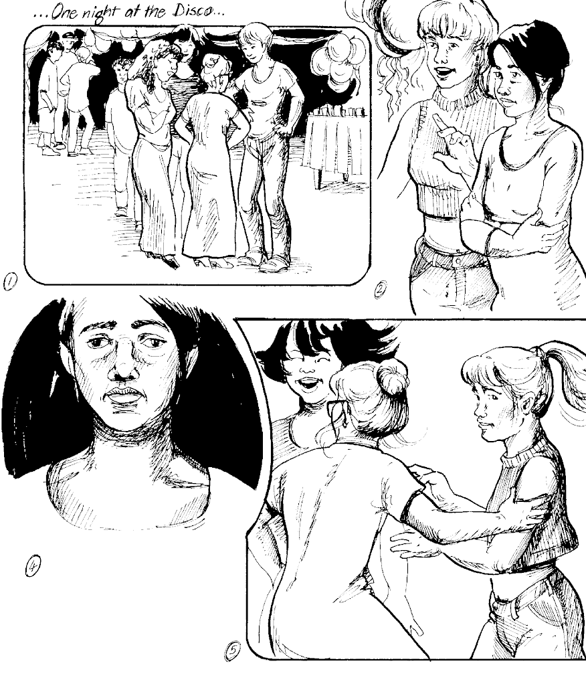
Senior primary
Keeping one step ahead
I’m responsible for others too
Finding out about abuse
Families working together
Reporting abuse
What happens now?
Notes:
Note 1: You can choose to remove this slide if it is not applicable to this school.
Note 2: This slide could be presented by the senior syndicate leader.
Refer to focus areas:
Keeping one step ahead
Choosing safe options
I’m responsible for others too
Bullying
Caring for others
Finding out about abuse
Identifying abuse
Feelings about abuse
Responding to abuse
Families working together
Family discipline
Family stress
Reporting abuse
Deciding what to do
Reporting abuse
What happens now?
What happens after I tell?
Sharing new knowledge

Slide 17
Years 9-10 and 11-13
Core health module
  Identifying abuse
  Recognising and avoiding abuse
  Knowing what to do
  Getting help
Activity bank
  20 activities for years 9-10, 11-13 and transition.
Notes:
Note 1: You can choose to remove this slide if it is not applicable to this school.
Note 2: This slide could be presented by the appropriate Head of Department or teacher.
Explain that it has
core health modules for years 9-10 and 11-13
an activity bank.
Explain that the activity bank:
contains 20 activities
can be used in a variety of ways and at different times by the school, to ensure that KOS is regularly and consistently presented throughout the year.
Suggestions for use:
Delivered by form or home group teachers in form time.
Delivered by subject teachers as part of the curriculum.
Delivered by Health co-ordinator in partnership with subject teacher.
Delivered by Guidance Counsellors or Deans in partnership with teachers.
Delivered by peer or associate leaders, supported by teachers.
Delivered by SCOs in partnership with teachers.
Year 13 students facilitate activities with Years 9-10.
As a special KOS lesson taught across all classes at one time with the teacher who usually takes the class at that time.

Slide 18
School Community Officer’s role

Slide 19
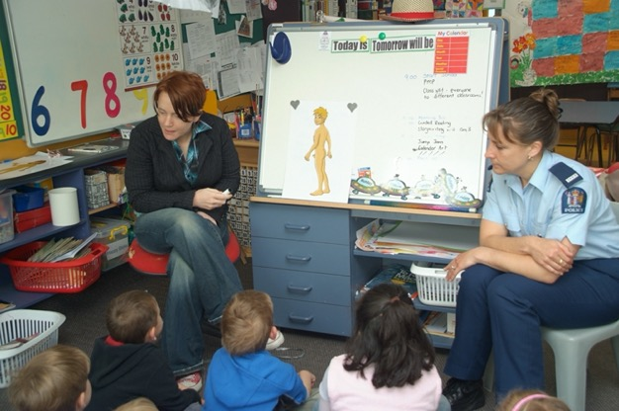
The role of the SCO
Determines the need for KOS.
Assists school with whole school approach.
Co-teaches up to three lessons with the class teacher.
Assists with evaluation.
Helps school become
self-sustaining.
Notes:
Explain that the SCO’s role is to:
Determine need for KOS.
SCO works with schools, community, other police and other stakeholders to determine risk and need.
Assist school with whole school approach
Schools need to do much more than just teach KOS.
They go through steps, including that:
the whole school community is committed to keeping students and staff free from harm and abuse
parents and caregivers are informed and consulted
a child protection policy and procedures have been developed and shared.
Teach up to three lessons with the class teacher.
The classroom teacher is the person best suited to teach KOS, because they know the children. The SCO assists with specialist knowledge.
Assist with evaluation.
They help make sure the learning outcomes for students are achieved.
Help school become self-sustaining.
Support the school to manage KOS in a self-sustaining way, regardless of police involvement.
See the implementation guide for more.

Slide 20
Parent, caregiver, whānau role

Slide 21
Support learning
Support and reinforce what your children are learning at school, through home activities and conversations.
Notes:
Explain that it is important that parents, caregivers and whānau are involved in what their child is learning in KOS and reinforce the same messages.
Things parents and whanau can do include:
attend a meeting at school to tell you more about KOS.
find out about abuse and what to do if you think a child you know is being abused.
talk to your child about what they have learnt in KOS.
set safety guidelines with your family.
help young children with the KOS activities they bring home.
give the same safety messages as the school is giving.
Show examples of home activities from some key learning experiences – they can use this time to talk with their child about what they are learning.

Slide 22
Information on KOS
Information for parents and KOS programme materials are available on the NZ Police website police.govt.nz – search for Keeping Ourselves Safe
Notes:
Point out that
Information for parents and the programme materials can be found on the NZ Police website, police.govt.nz
the easiest way to find them is to use the search function on the website

Slide 23
About abuse
Notes:
NOTE: You can use some, or all, of this section any where you think best for your audience.
Parents are often most keen to hear about the programme and what their children will do.

Slide 24
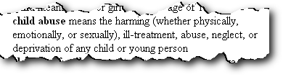
What is child abuse?
What is the definition of child abuse?
Oranga Tamariki Act, 1989 : Section 2
Notes:
Ask meeting to suggest what might be in a definition of abuse.
Click mouse to bring up OT Act definition.
Explain that in KOS, abuse is defined as:
“Abuse occurs when anybody uses power over another person and causes them harm. This could include hurting them physically, ill treating them or failing to take care of their everyday needs, touching them in sexual ways or showing them sexual materials, or hurting their feelings and damaging their sense of well being. It also includes violence that happens within families. Abuse can harm a child’s health, their dignity and may make it hard for them to learn and develop.”

Slide 25
Types of abuse
What are the different types of abuse?
Physical
Sexual
Emotional
Neglect
Cyber abuse
Family harm
Notes:
Ask groups to identify the different main types of abuse.
Share group answers.
Click mouse to bring up the types of abuse covered in KOS:
physical
sexual
emotional
Neglect
cyber abuse
family harm
Optional:
Do Activity 2 from Year 4-6 KOS.

Slide 26
Stranger danger?
‘In the majority of cases the abusers are known and trusted by their victims.’
‘The emphasis on ‘stranger danger’ causes adults to miss the clues that children give when they are being victimised by trusted family friends, professionals or relatives.’
  (Professor Freda Briggs)
Notes:
Quotes from Freda Briggs - Emeritus Professor in child development, researcher and lecturer in sociology, child protection at the University of South Australia, Magill Campus.
Explain that instead of concentrating on the type of person to keep away from (‘stranger danger’), KOS teaches children and young people the behaviours to identify and avoid, whether they are from people known or unknown to them (‘behaviour danger’).
Explain that idea of ‘stranger danger’ was dangerous because:
it made it easier for people who didn’t ‘look like strangers’
it failed to protect from the huge amount of non-stranger abuse
It was confusing because children do have to interact with strangers if they need help etc.

Slide 27
Abuse facts
1 in 4-5 females, and 1 in 6-8 males report unwanted sexual touching
NZ has the fifth worst child abuse record of the 31 OECD countries
On average 1 child is killed every 5 weeks. 90% by someone they knew
Only 8-12% were reported to any organisation
Notes:
Discuss who abuses children:
Abuse happens in all communities, regardless of their ethnic, socio-economic, geographic and religious make up.
Men and women.
Elderly down to same age as child.
Stranger danger approach not appropriate as the majority of abusers are known to the child.
The statistics in this slide come from 2019.
https://www.orangatamariki.govt.nz/statistics/quarterly-reporting/quarterly-report-december-2019/care-and-protection-statistics-2/
Magnitude of crime type
1 in 4-5 females, and 1 in 6-8 males report unwanted sexual touching (International and national research)
NZ has the fifth worst child abuse record out of 31 OECD Countries
On average 1 child is killed every 5 weeks (most under 5 years old). 90% by someone they knew.
Significant under-reporting
Only 8-12% were reported to any organisation
Connections to later life issues (consequences)
sexualised behaviour
under achievement
substance abuse, health issues
crime relationship (victimised and offending).

Slide 28
Digital citizenship
Children need to learn to participate in the online world safely, just as they do in the physical world.
Parents can ask simple questions to encourage their children to share their online activities.
Visit Netsafe for advice: netsafe.org.nz
Notes:
Relevant for parents of older children who ask about cyber safety
The risks in the online world are real but children can learn to act safely in that world and behave as responsible digital citizens.
The online world is as much part of life today as the physical world, and it is not going away.
While KOS is not primarily a cyber safety programme, the competencies children develop throughout the programme will help them in both the physical and online worlds.
The principles learnt in KOS apply to the physical and online world. We don't let our kids walk all around town without knowing where they are, then why do it online?
Statistics from Netsafe cyber survey report 2019 for AGES 9-17:
New Zealand children’s experiences of online risks and their perceptions of harm
https://www.netsafe.org.nz/wp-content/uploads/2020/02/Ng%C4%81taiohimatihikooAotearoaNZchildrensexperiencesofonlinerisksandharm.pdf
Some summary findings:
Nearly a quarter of all 9-17-year-old children said they had been treated in a hurtful or nasty way either online or offline or both.
Online hurtful behaviour was more commonly experienced by older children (12-17).
1 in 4 New Zealand children (9-17 years old) said that they had been bothered or upset by something that happened online in the last year.
Nearly half of teens (13-17) said they were exposed to at least one of the six different types of potentially harmful online content the survey asked about.
Statistics from the Lighthouse project
https://thelightproject.co.nz/the-facts/porn-fact-sheet/
Of NZ children who say they’ve seen pornography on the internet, one in four of them say they first saw it when they were less than12 years old.

Slide 29
Dealing with abuse
Believe what they say
Show love, concern and support
Keep your feelings to yourself
Keep calm
Listen carefully
Reassure them it isn’t their fault
Say you’re pleased they’ve told you
Say you’ll help them
Seek help
Report to Oranga Tamariki or Police
Notes:
Explain the following steps for what to do if a child discloses:
Believe and accept what they say:
“Thank you for telling me. I believe you.”
Show your love, concern and support.
“I love you very much. I’m here if you want me to listen.”
Keep your feelings to yourself.
Keep any feelings you might have, such as anger, fear, guilt or disgust, to yourself. Children will notice your reactions to what they tell you. If you get angry, children might think you’re angry with them and may not tell you again.
Keep calm.
If you show shock, your child will withdraw and the truth may never be known.
Listen carefully to what is said.
Don’t interrogate or question a child about what has happened. A person trained to deal with abuse can talk with your child at a later time. This will probably be very difficult, as you will want to find out as much as possible from your child. However, questioning from you could influence the outcome of any court proceedings at a later date.
Reassure them that it is not their fault.
Tell children that they are not to blame for what someone else has done to them. “I am very sorry that this has happened to you. What happened was NOT your fault. That person should not have done that to you.”
Tell them you’re pleased they’ve told.
Tell them that you are pleased that they have told you and that you are very sorry about what has happened. Explain that this happens to a lot of children and praise them for telling you. “You are very brave for telling me. I am very pleased that you have told me.”
Assure them that you will do something to help.
Seek help.
Seek help and advice for you and your child. Dealing with abuse is painful and you need to find someone that you can trust, someone who has heard these things before and will not judge you or your family.
Report to Oranga Tamariki or Police
Report the abuse to either a member of a child protection team at your local police station or to Oranga Tamariki.
If you report, you are legally protected unless you acted in bad faith.
Adapted from No Excuse for Abuse! , Safer Streets Trust (now the Young New Zealanders’ Foundation), in consultation with Professor Freda Briggs of the University of South Australia and Professor Steven Rollin of the State University of Florida.

Slide 30
Questions and answers
Notes:
Take questions.
Refer any specific questions relating to the school implementation to school staff at the meeting.
Invite audience members to contact you later if there is anything they wish to ask in private.

Slide 31
Memorandum of understanding
Notes:
Note: Remove this slide, and the reference to it in the agenda, if you are not signing the Memorandum of Understanding at the meeting.
Introduce the Letter of Agreement from the primary school implementation guide.
Have the appropriate people sign copies of the letter in front of the audience.

Slide 32
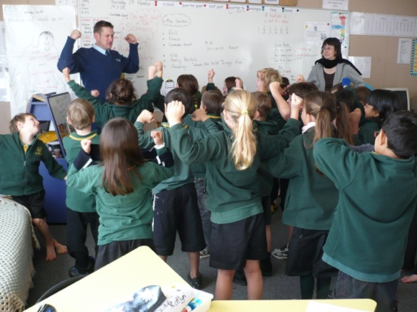
Take care of our children.
Take care of what they hear.
Take care of what they see.
Take care of what they feel.
For how the children grow,
so will the shape of Aotearoa.
Dame Whina Cooper
Notes:
Conclude with this is a quote from Māori leader Dame Whina Cooper – (quote taken from CYFS Working Together Interagency Guide, page 6).
Explain that by being more aware of our responsibilities we can all join together to help children avoid abuse.

