Slide 1
Christchurch Pilot – information for agencies
A new way of responding to family violence
29 June 2016
www.police.govt.nz/integratedsafetyresponse

Slide 2
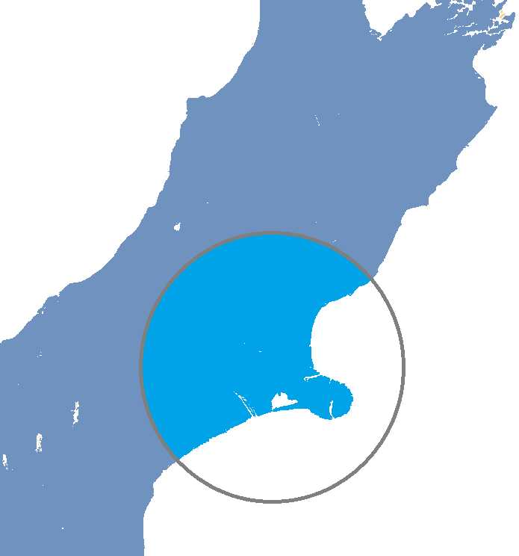
What is Integrated Safety Response?
A new multi-agency approach to responding to family violence
Iwi represented at every level
Part of the Government's family violence and sexual violence work programme
A pilot from 1 July 2016 to ensure a new national model is robust, adaptable and makes a real difference to the lives of victims and families
Covers Christchurch Metro, North Canterbury and Selwyn
Replaces the existing Round Table and Family Violence Interagency Response systems (FVIARS) in those areas and accepts referrals from Police and Corrections.
Notes:
The Integrated Safety Response (ISR) to Family Violence is a police-led multi-agency project, and the development and implementation of the model has involved Police, CYF, MSD, Justice, ACC, CDHB, Ministry of Health, Iwi, Education, Te Puni Kokiri and a large number of regional NGOs and victim advocacy services. ISR represents a truly multi-agency and community response to family violence.
ISR is part of the wider Ministerial Group for Family Violence and Sexual Violence work programme. Other parts of the programme include workforce development, a family violence risk assessment and management framework and consolidating functional leadership in the primary prevention and perpetrator service areas.
ISR is the multi-agency response and safety planning system to respond to violence within families. It will replace the existing FVIARS system in the areas that it is piloted. Like FVIARS, ISR will accept referrals from Police. It will also accept referrals from Corrections for offenders pending release from Prison who are identified as being at high risk of perpetrating family violence, and who will be living in the pilot coverage area.
During the period of the pilot, one ISR team will cover the areas of Christchurch, North Canterbury and the Selwyn district. This will replace the existing FVIARS and Round Table responses operating in these areas.
Some ISR staff, e.g. Child, Youth and Family staff, will base themselves at the Christchurch Central Police station for the duration of the pilot.

Slide 3
Why is this important to us?
Family violence is a terrible reality for thousands of New Zealand families.
Police visit 150 – 170 households every week across Christchurch, North Canterbury and Selwyn.
In 2015, Police conducted 109,328 family violence investigations; and 76,041 notifications about child maltreatment were made to Child, Youth and Family.
On average Police respond to a family violence incident every 4.9 minutes and each day Police visit 299 homes in response to family violence.
Half of all homicides are family violence related.
49% of Māori women experience partner abuse (compared with 24% non- Māori). One out of two children killed by caregivers are Māori.
About half of all violent offence charges in our courts relate to family violence and half of all homicide victims are killed by a family member or someone they had been in a relationship with.
Notes:
Family violence causes significant and widespread harm to families. ISR is about working with our partners, both in government and in the community, to reduce and prevent violence in families, and protect children and young people from the harm it causes and to support them heal.
Family violence is about cumulative harm. Repeated exposure to violence, especially involving loved ones, creates chronic stress, which strengthens neural pathways associated with anxiety and fear, while other parts of the brain become under-developed. Over time, these effects can cause permanent change (Cumulative Harm: A Conception Overview, Victoria Government, 2007).
Children exposed to family violence throughout their childhood are more likely to become involved in abusive and violent adult relationships; sometimes in families we call this intergenerational violence.

Slide 4
What are the objectives?
After family violence has been reported to Police or referred from Corrections [high risk prison releases in Christchurch] …
To improve safety management as soon as possible
To ensure early identification and appropriate responses to at-risk whānau at the first opportunity so as to:
manage perpetrators
reduce re-victimisation/re-offending and
improve long-term outcomes.

Slide 5
Who is involved?
Safety Assessment Meeting (SAM) team
Police
Child Youth and Family
Corrections
Health
Iwi/Māori
Intensive Case Management (ICM) team
SAM agencies PLUS:
ACC
Housing New Zealand
Education
Ministry of Justice
Work and Income
We work collectively
Notes:
Family Violence episodes reported to Police and high risk, family violence prison releases are referred to the daily Safety Assessment Meeting (SAM).
High risk cases are referred to an Independent Victim Advocate and are supported by the SAM agencies and a wider set of agencies that meet weekly for Intensive Case Management.
In addition to these two forums, operational managers will meet monthly to address issues and risks, such as overdue tasks, resource requirements.
Every two months the local Government Group will meet to oversee the pilot and consider trends and area-wide issues.

Slide 6
What’s involved?
A key feature is the identification of ‘high risk’ victims and an independent family violence specialist to support these victims to reduce the risk of further violence.
The new approach has a family/whānau focus – it aims to assess and support the whole family’s needs. Perpetrators of violence will be managed.

Slide 7
Key features of the model
A response to every reported episode
Daily safety assessment meetings
Dedicated support, coordination and oversight roles
Independent Victim Specialist and Perpetrator outreach services
2nd level intensive response for high risk cases
Evidence based risk assessment framework
Joint training and ongoing professional development
Information sharing and privacy training and resources
Governance and strategic oversight
Case management solution
Notes:
A response to every reported episode:
Every referral to ISR (from Police or Corrections) will receive a response. The response will be shaped by the level of assessed risk, and by the needs of those involved.
Daily safety assessment meetings
Safety Assessment Meetings (SAM) to assess risk and develop a response (Family Safety Plan) will be held at least every week day. Once the pilot is established, the possibility of moving to a 7 day model will be explored.
SAM meetings will be attended by CYF, Police, Probation, Iwi, CDHB, an NGO Coordinator, the Operations Manager and the ISR Administrator.
Dedicated support, coordination and oversight roles The model incorporates a number of core dedicated roles.
A Regional Director will be responsible for strategic oversight, for understanding the needs of families and communities and for working with governance and the wider family violence response sector to meet identified needs.
An Operations Manager will be responsible for coordinating and managing the day to day operations of the ISR model, and for facilitating SAMs.
A NGO Coordinator will be responsible for interfacing between ISR and NGOs, for relationship management, for ensuring allocated tasks are provided
to the right service providers, and for working with the Director to identify service gaps.
An Administrator will be responsible for entering intakes into the system from Police and Corrections, for recording Family Safety Plans during SAM meetings, for managing the Case Management Solution, and for developing reports for the Director and Governance.
Independent Victim Specialist and Perpetrator Outreach Services
Two Independent Victim Specialists (IVS) and a Perpetrator Outreach Service will support victims, help keep them safe and provide essential services to perpetrators in high risk cases, particularly in areas where service gaps have been identified.
AVIVA in partnership with He Waka Tapu has been contracted to provide these services for the duration of the Christchurch pilot.
2nd level intensive response for high risk cases
A small number of cases identified as high risk will move into the Intensive Case Management (ICM) process. This involves more intensive support, the engagement of the IVS and the Perpetrator Outreach services, and is coordinated through weekly ICM meetings that involve SAM participants in addition to others such as Justice, Work and Income, ACC and Education on an as needed basis.
Evidence based risk assessment framework
The quality and consistency of decision making at SAM and ICM will be supported by an ISR risk assessment framework and guide.
Joint training and on-going professional development
All core ISR roles will participate in more than eight full days of specialist training, some of which is open to a wider group of people involved in ISR in different capacities. On-going training will be provided and will be tailored to development needs identified during the pilot.
Information sharing and privacy resources
ISR participants will be provided with information sharing and privacy training, and a number of privacy and information sharing resources will be used to promote purposeful and effective information sharing that keeps people safe whilst avoiding the needless sharing of personal information.
Governance and strategic oversight
ISR is overseen by regional governance and, should the model be rolled out nationally, national governance. Governance is responsible for strategic decision making, and will be informed by the growing body of analytics and data generated by the ISR process and case management solution. Governance and strategic oversight means that the needs of families and communities will be better understood overtime, service gaps identified and plans developed to overcome these.
Case management solution
A case management solution will be used to record information about episodes, develop and track plans, keep people accountable for agreed actions, record outcomes, and to collect and generate analytics about the nature of family violence in the region, and the needs of services and the community.

Slide 8
What does this mean for agencies in the pilot area?
Police referrals will be considered by ISR instead of FVIARS.
Practitioners will be working in an Integrated Safety Response role (not FVIARS or round table).
Cases that are open with agencies already may receive additional tasks or requests to undertake actions from ISR. These will be requested through agency representatives at ISR.
ISR staff will be a helpful resource because of their expertise in family violence.
Over time, we will better understand service gaps and the role we can play in helping address these.
Core partners will receive anonymised reports on the analytics and data collected and stored in the new case management solution.

Slide 9
What will be the benefits?
Families receive faster and integrated support and services following a family violence incident.
Victims are safer and feel supported.
The needs of victims (to be safe) and perpetrators (to stop harmful behaviour) are considered together in a family-centred response.
Increased reporting of family violence because victims and those who know about the violence have more confidence in the system.
Fewer perpetrators re-offend.

Slide 10
Where can I get more information?
Check out the web section: www.police.govt.nz/integratedsafetyresponse
[Agency to customise]
Notes:
Note: on the website you can download the A3 ISR on a page

